Slide 1
SLIDE-BY-SLIDE REBUTTAL
BVSD has not proved these closures are necessary.
A response to the August 25, 2026 Resilient Schools Proposal
Schools are public infrastructure—not businesses required to run at maximum occupancy.
Notes:
[Sources]
- https://go.boarddocs.com/co/bvsd/Board.nsf/pfiles/DXBFUX40E0C7/$file/Resilient%20Schools%20Proposal%20FINAL%2008-25-2026%20(1).pdf
- https://www.bvsd.org/fs/resource-manager/view/a3084131-2460-4b0e-b752-d0f82216f12d
- https://www.bvsd.org/current-topics/declining-enrollment
[/Sources]

Slide 2
The proposal is a policy choice—not a financial emergency
BVSD’s own numbers show disproportionate disruption for a modest financial and utilization gain.
~85%
0.8–0.9%
32.1%
of operating revenue comes from local tax sources
of operating revenue is the estimated annual savings
of Boulder seats remain empty even after the closures
Local sources = two property-tax lines plus equalized vehicle ownership tax in BVSD’s proposed 2026–27 operating budget.
Notes:
Calculations: $3.5–$4.0M / $440.114931M = 0.80–0.91%. Local tax sources: 19.9% + 61.6% + 3.4% = 84.9%.
[Sources]
- https://www.bvsd.org/fs/resource-manager/view/a3084131-2460-4b0e-b752-d0f82216f12d
- https://go.boarddocs.com/co/bvsd/Board.nsf/pfiles/DXBFUX40E0C7/$file/Resilient%20Schools%20Proposal%20FINAL%2008-25-2026%20(1).pdf
- https://boulderreportinglab.org/2026/08/25/bvsd-proposes-closing-four-elementary-schools-in-sweeping-consolidation-plan/
[/Sources]

Slide 3

RESPONSE TO BVSD SLIDE 1
“Resilience” is not consent
THE ANSWER
•
A slogan cannot substitute for a necessity finding.
•
BVSD must prove closure is the least harmful option—not simply label disruption resilient.
•
SOLUTION: Require a written necessity finding and price the baseline-plus-variable alternative before any closure vote.
BVSD’S SLIDE
1 / 75
Notes:
[Sources]
- User-supplied: BVSD Board Union Solutions Brief (September 2, 2026)
- BVSD Collective Bargaining and Staffing Cliffs Board Brief (September 2026)
- BVSD 2026-27 Proposed Budget, School Allocation Formulas
[/Sources]

Slide 4

RESPONSE TO BVSD SLIDE 2
Do not weaponize resilience
THE ANSWER
•
The community’s history of surviving crises does not create an obligation to accept avoidable closures.
•
Keeping a successful neighborhood school open can itself be resilience.
•
SOLUTION: Define resilience as stable staffing: a building floor plus gradual enrollment-based additions.
BVSD’S SLIDE
2 / 75
Notes:
[Sources]
- User-supplied: BVSD Board Union Solutions Brief (September 2, 2026)
- BVSD Collective Bargaining and Staffing Cliffs Board Brief (September 2026)
- BVSD 2026-27 Proposed Budget, School Allocation Formulas
[/Sources]

Slide 5
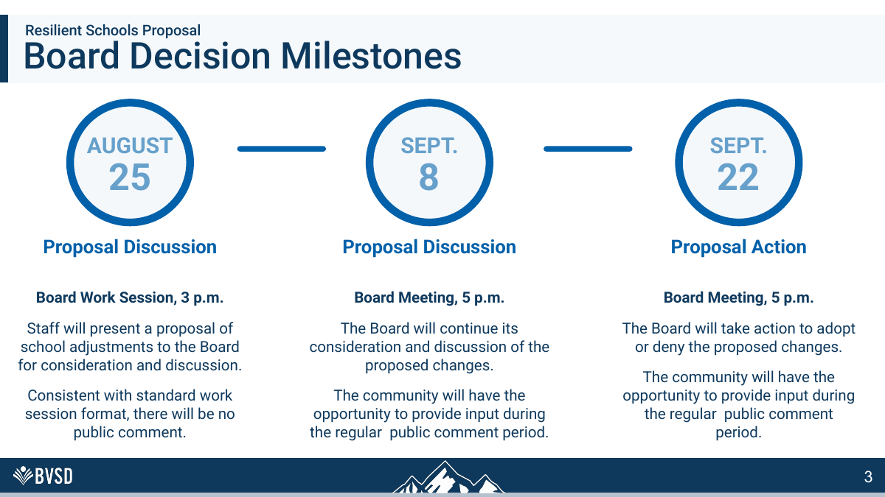
RESPONSE TO BVSD SLIDE 3
The decision window is too short
THE ANSWER
•
The public sees the final plan August 25; the vote is September 22—just 28 days.
•
Only two regular-comment opportunities follow release of the proposal.
•
SOLUTION: Delay the vote until BVSD publishes contract clauses, avoidable savings and a no-closure staffing model.
BVSD’S SLIDE
3 / 75
Notes:
[Sources]
- User-supplied: BVSD Board Union Solutions Brief (September 2, 2026)
- BVSD Collective Bargaining and Staffing Cliffs Board Brief (September 2026)
- BVSD 2026-27 Proposed Budget, School Allocation Formulas
[/Sources]

Slide 6

RESPONSE TO BVSD SLIDE 4
The scope excludes decisive facts
THE ANSWER
•
Future use of closed buildings is excluded, even though disposition affects the true economics.
•
Dual-language and mountain schools are excluded, so the districtwide “right number” of schools is not actually tested.
•
SOLUTION: Evaluate every school under one transparent formula, with public exceptions and an appeal process.
BVSD’S SLIDE
4 / 75
Notes:
[Sources]
- User-supplied: BVSD Board Union Solutions Brief (September 2, 2026)
- BVSD Collective Bargaining and Staffing Cliffs Board Brief (September 2026)
- BVSD 2026-27 Proposed Budget, School Allocation Formulas
[/Sources]

Slide 7

RESPONSE TO BVSD SLIDE 5
Incredible schools do not need to be erased
THE ANSWER
•
BVSD concedes these are not failing schools.
•
A high-performing, loved school is an asset—not excess inventory.
•
SOLUTION: Preserve successful schools while testing reversible staffing reforms before irreversible closures.
BVSD’S SLIDE
5 / 75
Notes:
[Sources]
- User-supplied: BVSD Board Union Solutions Brief (September 2, 2026)
- BVSD Collective Bargaining and Staffing Cliffs Board Brief (September 2026)
- BVSD 2026-27 Proposed Budget, School Allocation Formulas
[/Sources]

Slide 8
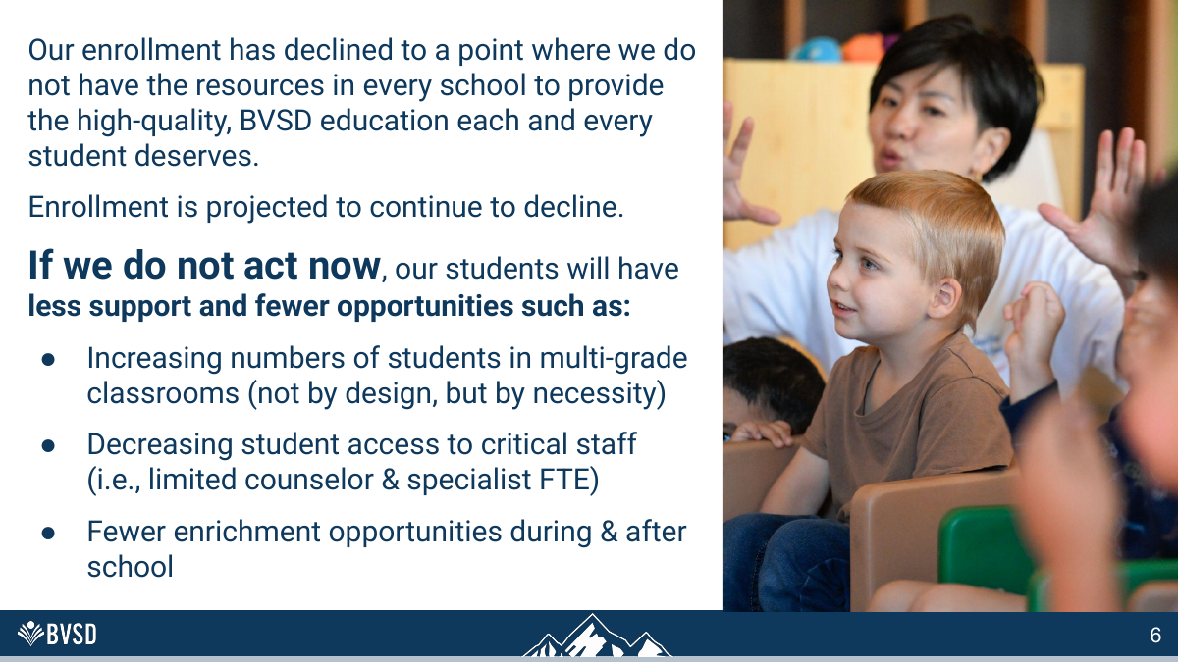
RESPONSE TO BVSD SLIDE 6
The staffing shortage is partly contract-made—and fixable
THE ANSWER
•
BVSD has four CBAs plus two non-CBA staffing frameworks—not six to eight union contracts.
•
Some cliffs are contractual; many principal, librarian, clerical, health and media thresholds come from the annual budget.
•
SOLUTION: Fund a principal, front office, counselor floor, library, arts, PE, health and custodial baseline per open school.
BVSD’S SLIDE
6 / 75
Notes:
[Sources]
- User-supplied: BVSD Board Union Solutions Brief (September 2, 2026)
- BVSD Collective Bargaining and Staffing Cliffs Board Brief (September 2026)
- BVSD 2026-27 Proposed Budget, School Allocation Formulas
[/Sources]

Slide 9

RESPONSE TO BVSD SLIDE 7
Contracts do not make closure inevitable
THE ANSWER
•
No identified contract clause requires BVSD to close a school because enrollment falls.
•
The Board can redesign its own formulas now; contractual workload and placement rules can be changed by mutual agreement.
•
SOLUTION: Separate contractual protections from Board-controlled formulas; redesign the latter now and bargain the former.
BVSD’S SLIDE
7 / 75
Notes:
[Sources]
- User-supplied: BVSD Board Union Solutions Brief (September 2, 2026)
- BVSD Collective Bargaining and Staffing Cliffs Board Brief (September 2026)
- BVSD 2026-27 Proposed Budget, School Allocation Formulas
[/Sources]

Slide 10
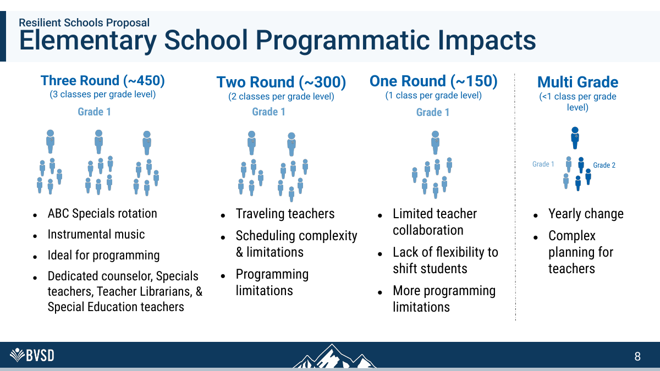
RESPONSE TO BVSD SLIDE 8
Three rounds is a staffing formula—not a contract mandate
THE ANSWER
•
BVEA’s K-5 class sizes are goals requiring ‘every reasonable effort,’ not an automatic new teacher for one student over.
•
The sharp specialist step table is contractual, but the three-round definition itself is BVSD’s policy choice.
•
SOLUTION: Replace the three-round rule with baseline staffing plus gradual additions for enrollment and student need.
BVSD’S SLIDE
8 / 75
Notes:
[Sources]
- User-supplied: BVSD Board Union Solutions Brief (September 2, 2026)
- BVSD Collective Bargaining and Staffing Cliffs Board Brief (September 2026)
- BVSD 2026-27 Proposed Budget, School Allocation Formulas
[/Sources]

Slide 11

RESPONSE TO BVSD SLIDE 9
Protect class size without forcing larger schools
THE ANSWER
•
A larger school does not automatically create smaller classes; section counts and staffing rules do.
•
Use rolling averages, buffers and a stabilization pool to honor workload protections without closure.
•
SOLUTION: Guarantee school-level class sizes and services directly instead of using total enrollment as a proxy.
BVSD’S SLIDE
9 / 75
Notes:
[Sources]
- User-supplied: BVSD Board Union Solutions Brief (September 2, 2026)
- BVSD Collective Bargaining and Staffing Cliffs Board Brief (September 2026)
- BVSD 2026-27 Proposed Budget, School Allocation Formulas
[/Sources]

Slide 12

RESPONSE TO BVSD SLIDE 10
Demographics explain change, not closure
THE ANSWER
•
Fewer births and expensive housing are real, but they do not establish the educationally best response.
•
Schools are long-lived public infrastructure; utilization naturally rises and falls across demographic cycles.
•
SOLUTION: Use a three-year rolling enrollment average so one demographic dip does not trigger permanent closure.
BVSD’S SLIDE
10 / 75
Notes:
[Sources]
- User-supplied: BVSD Board Union Solutions Brief (September 2, 2026)
- BVSD Collective Bargaining and Staffing Cliffs Board Brief (September 2026)
- BVSD 2026-27 Proposed Budget, School Allocation Formulas
[/Sources]

Slide 13
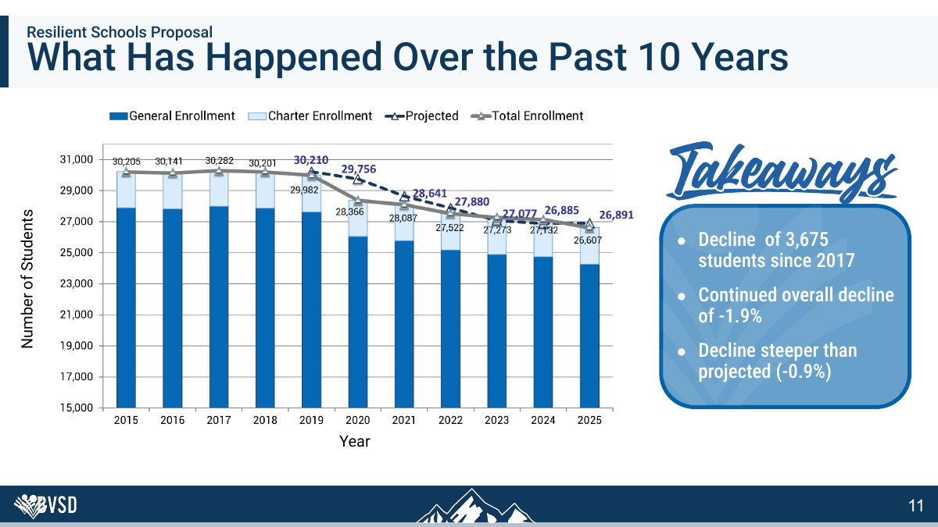
RESPONSE TO BVSD SLIDE 11
Past decline does not dictate one remedy
THE ANSWER
•
A 3,675-student decline is districtwide; it does not show that Flatirons itself harms students or finances.
•
BVSD should publish fixed versus variable cost by building and savings net of transition costs.
•
SOLUTION: Add a 3-student or 5% buffer and confirm changes through two official enrollment counts.
BVSD’S SLIDE
11 / 75
Notes:
[Sources]
- User-supplied: BVSD Board Union Solutions Brief (September 2, 2026)
- BVSD Collective Bargaining and Staffing Cliffs Board Brief (September 2026)
- BVSD 2026-27 Proposed Budget, School Allocation Formulas
[/Sources]

Slide 14
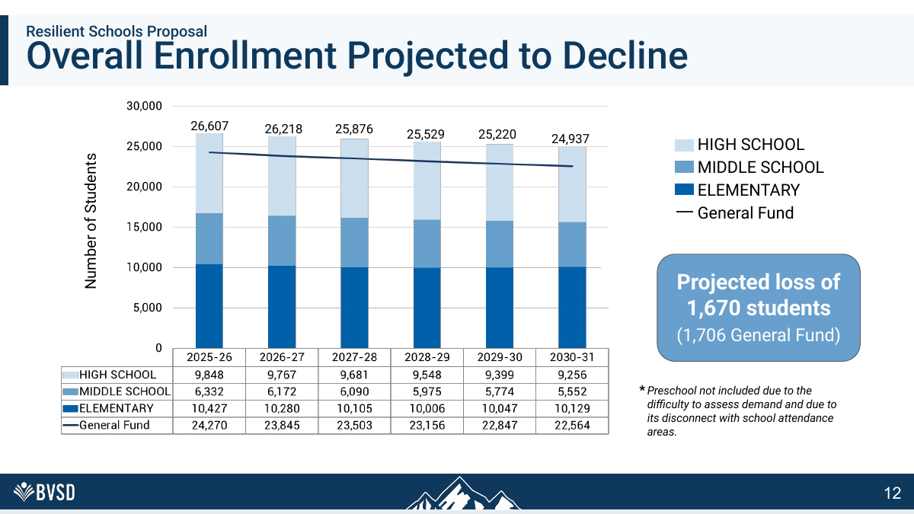
RESPONSE TO BVSD SLIDE 12
Forecasts need ranges and triggers
THE ANSWER
•
BVSD admits decline was steeper than its prior projection, showing forecasts are uncertain.
•
Use annual triggers and reversible steps before permanent closure.
•
SOLUTION: Publish forecast ranges and use one-year hold-harmless funding when schools sit near a threshold.
BVSD’S SLIDE
12 / 75
Notes:
[Sources]
- User-supplied: BVSD Board Union Solutions Brief (September 2, 2026)
- BVSD Collective Bargaining and Staffing Cliffs Board Brief (September 2026)
- BVSD 2026-27 Proposed Budget, School Allocation Formulas
[/Sources]

Slide 15
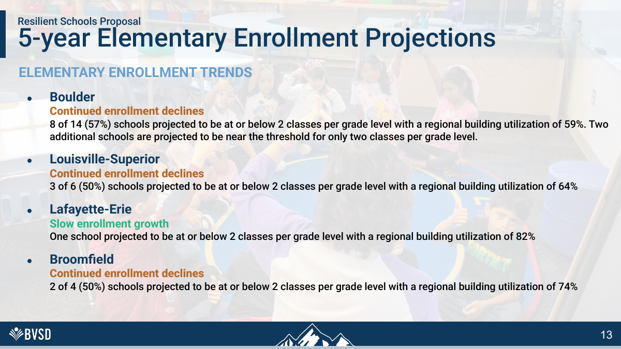
RESPONSE TO BVSD SLIDE 13
A regional average hides school reality
THE ANSWER
•
A 59% regional utilization figure says nothing about class size, traffic, cafeterias or special-program space.
•
“Two classes per grade” is an administrative threshold, not a demonstrated educational minimum.
•
SOLUTION: Price a district enrollment-stabilization reserve before treating a projected decline as a closure mandate.
BVSD’S SLIDE
13 / 75
Notes:
[Sources]
- User-supplied: BVSD Board Union Solutions Brief (September 2, 2026)
- BVSD Collective Bargaining and Staffing Cliffs Board Brief (September 2026)
- BVSD 2026-27 Proposed Budget, School Allocation Formulas
[/Sources]

Slide 16
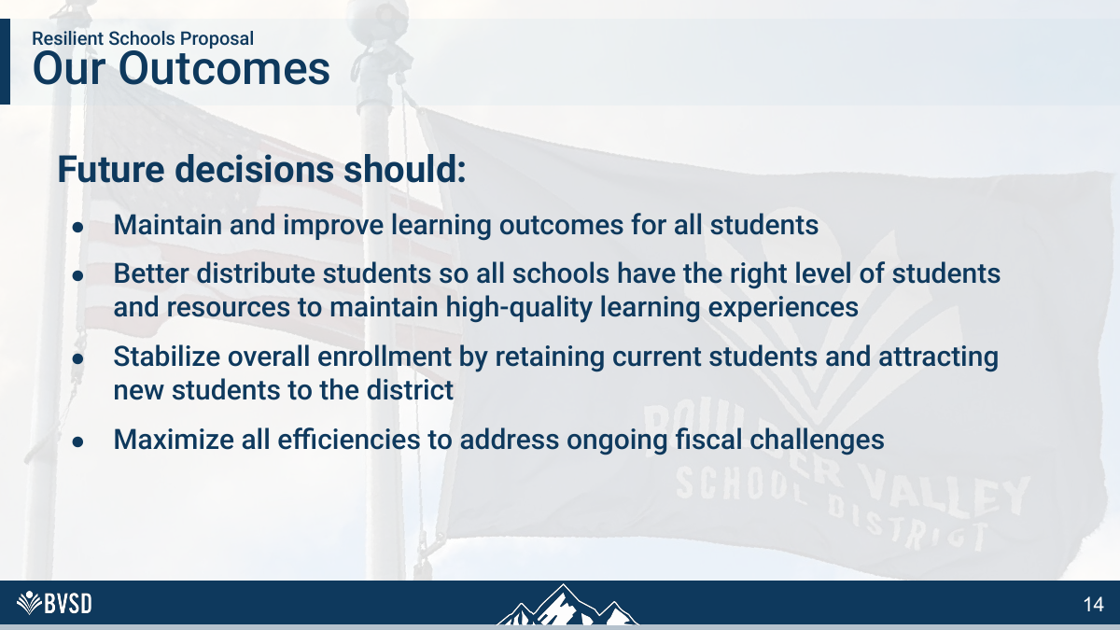
RESPONSE TO BVSD SLIDE 14
Define “right level” before voting
THE ANSWER
•
BVSD never proves that 450 is the right school size for Boulder children.
•
Efficiency must be balanced against walkability, belonging, congestion and disruption.
•
SOLUTION: Report marginal avoidable cost—not average cost per student—and keep fixed public-service costs separate.
BVSD’S SLIDE
14 / 75
Notes:
[Sources]
- User-supplied: BVSD Board Union Solutions Brief (September 2, 2026)
- BVSD Collective Bargaining and Staffing Cliffs Board Brief (September 2026)
- BVSD 2026-27 Proposed Budget, School Allocation Formulas
[/Sources]

Slide 17

SOLUTION: Show which costs disappear and which simply transfer to receiving schools, transportation or central services.
A divider is not evidence
THE ANSWER
•
Community engagement matters only if it can change the recommendation.
•
The record should show which feedback altered the plan—and which was rejected, with reasons.
BVSD’S SLIDE
15 / 75
Notes:
[Sources]
- User-supplied: BVSD Board Union Solutions Brief (September 2, 2026)
- BVSD Collective Bargaining and Staffing Cliffs Board Brief (September 2026)
- BVSD 2026-27 Proposed Budget, School Allocation Formulas
[/Sources]

Slide 18
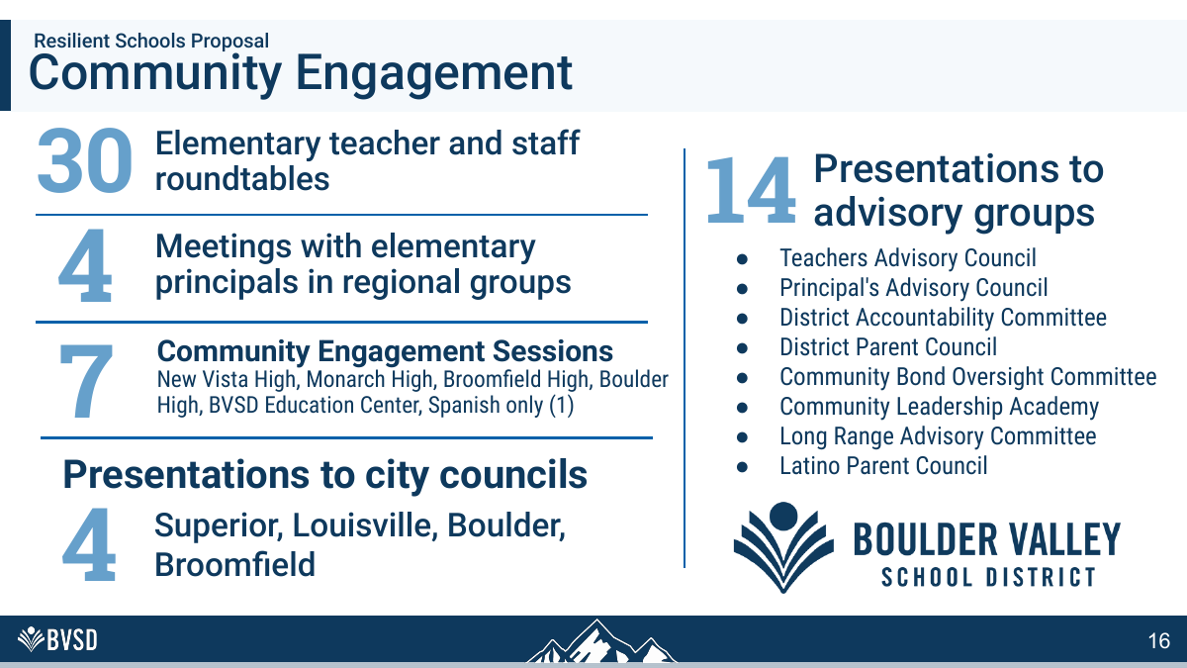
RESPONSE TO BVSD SLIDE 16
Meeting counts are not representation
THE ANSWER
•
BVSD reports events, not who participated, response rates, demographic weighting or affected-school consent.
•
Six thousand responses are not six thousand unique, representative residents unless methodology proves it.
•
SOLUTION: Publish each staffing change caused by a threshold crossing during the last five years.
BVSD’S SLIDE
16 / 75
Notes:
[Sources]
- User-supplied: BVSD Board Union Solutions Brief (September 2, 2026)
- BVSD Collective Bargaining and Staffing Cliffs Board Brief (September 2026)
- BVSD 2026-27 Proposed Budget, School Allocation Formulas
[/Sources]

Slide 19
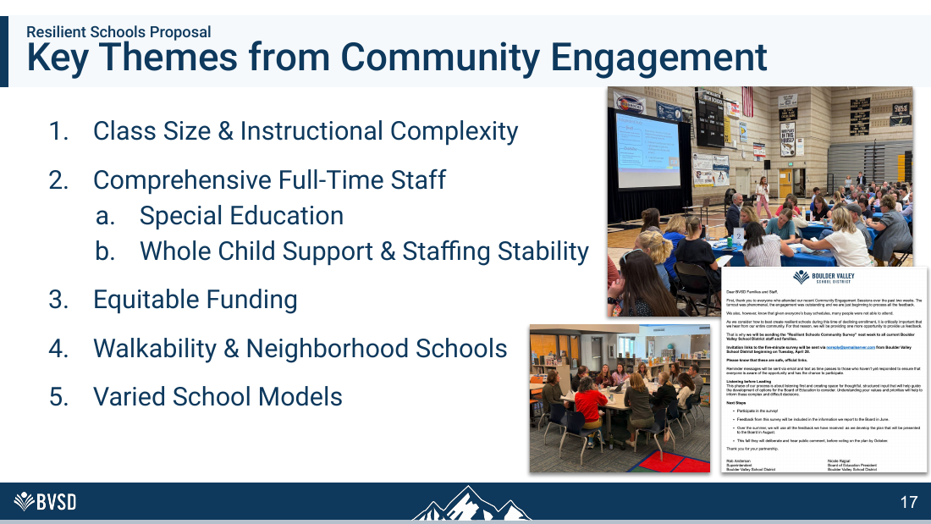
RESPONSE TO BVSD SLIDE 17
BVSD selected only half the feedback
THE ANSWER
•
The community also prioritized walkability, neighborhood schools and varied models.
•
The proposal elevates staffing and class size while sacrificing the other stated priorities.
•
SOLUTION: Compare closure with a funded small-school model using identical service and class-size guarantees.
BVSD’S SLIDE
17 / 75
Notes:
[Sources]
- User-supplied: BVSD Board Union Solutions Brief (September 2, 2026)
- BVSD Collective Bargaining and Staffing Cliffs Board Brief (September 2026)
- BVSD 2026-27 Proposed Budget, School Allocation Formulas
[/Sources]

Slide 20

SOLUTION: Protect operating buffer for programs, forecast error and community use; do not target maximum loading.
The proposal is a choice, not fate
THE ANSWER
•
The word “proposal” matters: alternatives remain legally and financially possible.
•
Ask the Board to reject the false binary of closure or educational decline.
BVSD’S SLIDE
18 / 75
Notes:
[Sources]
- User-supplied: BVSD Board Union Solutions Brief (September 2, 2026)
- BVSD Collective Bargaining and Staffing Cliffs Board Brief (September 2026)
- BVSD 2026-27 Proposed Budget, School Allocation Formulas
[/Sources]

Slide 21

SOLUTION: Use rolling averages and buffers before converting neighborhood enrollment variation into building closure.
Broomfield deserves the same proof
THE ANSWER
•
A regional label does not answer whether each child receives a better experience.
•
Demand the same school-level cost, traffic, capacity and transition analysis in every region.
BVSD’S SLIDE
19 / 75
Notes:
[Sources]
- User-supplied: BVSD Board Union Solutions Brief (September 2, 2026)
- BVSD Collective Bargaining and Staffing Cliffs Board Brief (September 2026)
- BVSD 2026-27 Proposed Budget, School Allocation Formulas
[/Sources]

Slide 22
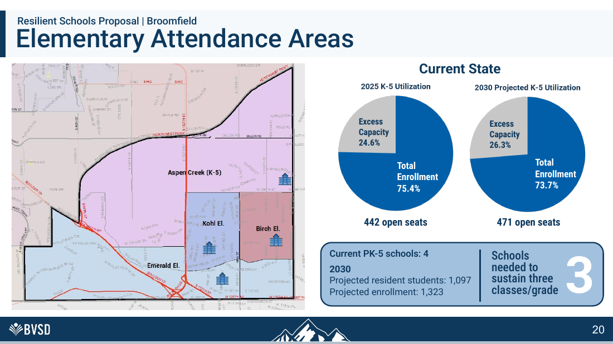
RESPONSE TO BVSD SLIDE 20
“Three schools needed” is circular
THE ANSWER
•
BVSD divides projected students by its preferred three-round size and calls the quotient “need.”
•
That is arithmetic built on an unproven policy assumption—not an independent finding.
•
SOLUTION: Require actual October counts—not one projection—to confirm any staffing reduction.
BVSD’S SLIDE
20 / 75
Notes:
[Sources]
- User-supplied: BVSD Board Union Solutions Brief (September 2, 2026)
- BVSD Collective Bargaining and Staffing Cliffs Board Brief (September 2026)
- BVSD 2026-27 Proposed Budget, School Allocation Formulas
[/Sources]

Slide 23
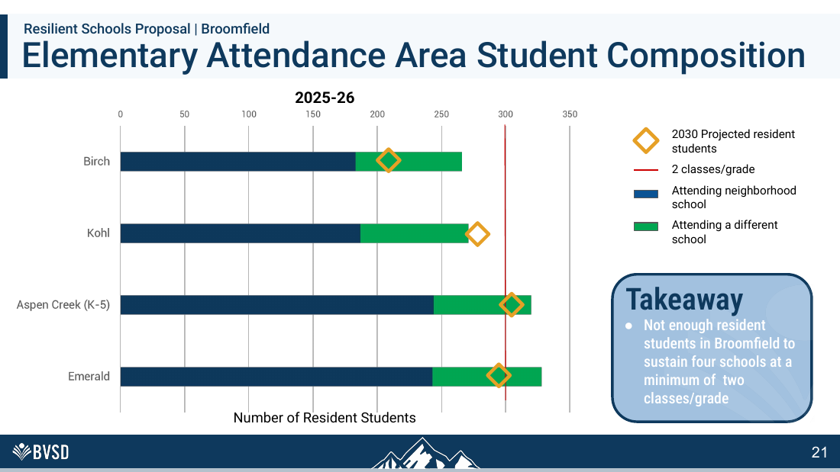
RESPONSE TO BVSD SLIDE 21
Resident count is not school demand
THE ANSWER
•
Families may choose focus, charter or other neighborhood schools; movement is part of the system BVSD designed.
•
A residence-only chart understates the role of program quality and family choice.
•
SOLUTION: Keep sections intact midyear when enrollment declines; use the stabilization reserve for temporary variance.
BVSD’S SLIDE
21 / 75
Notes:
[Sources]
- User-supplied: BVSD Board Union Solutions Brief (September 2, 2026)
- BVSD Collective Bargaining and Staffing Cliffs Board Brief (September 2026)
- BVSD 2026-27 Proposed Budget, School Allocation Formulas
[/Sources]

Slide 24
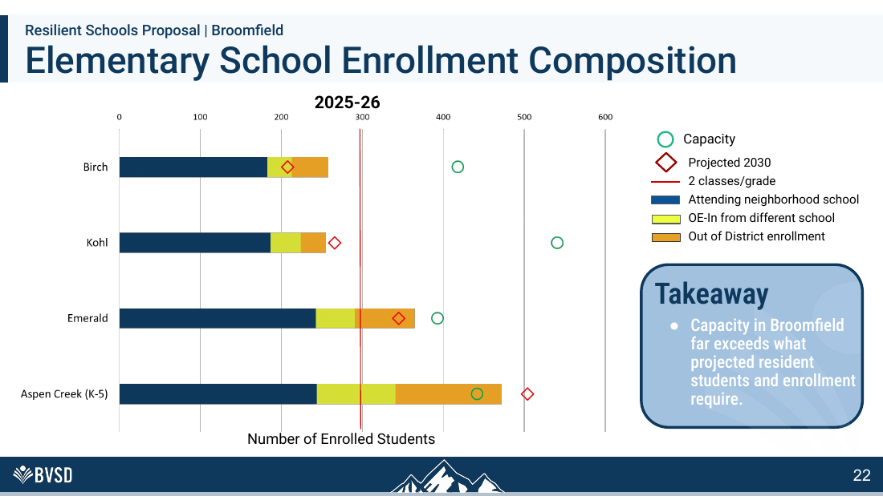
RESPONSE TO BVSD SLIDE 22
Empty seats are not educational failure
THE ANSWER
•
Capacity is a facilities ratio, not a student outcome.
•
Unused classrooms can support small classes, interventions, preschool and community programs.
•
SOLUTION: Allocate fractional FTE continuously so one student does not trigger a large staffing jump or loss.
BVSD’S SLIDE
22 / 75
Notes:
[Sources]
- User-supplied: BVSD Board Union Solutions Brief (September 2, 2026)
- BVSD Collective Bargaining and Staffing Cliffs Board Brief (September 2026)
- BVSD 2026-27 Proposed Budget, School Allocation Formulas
[/Sources]

Slide 25
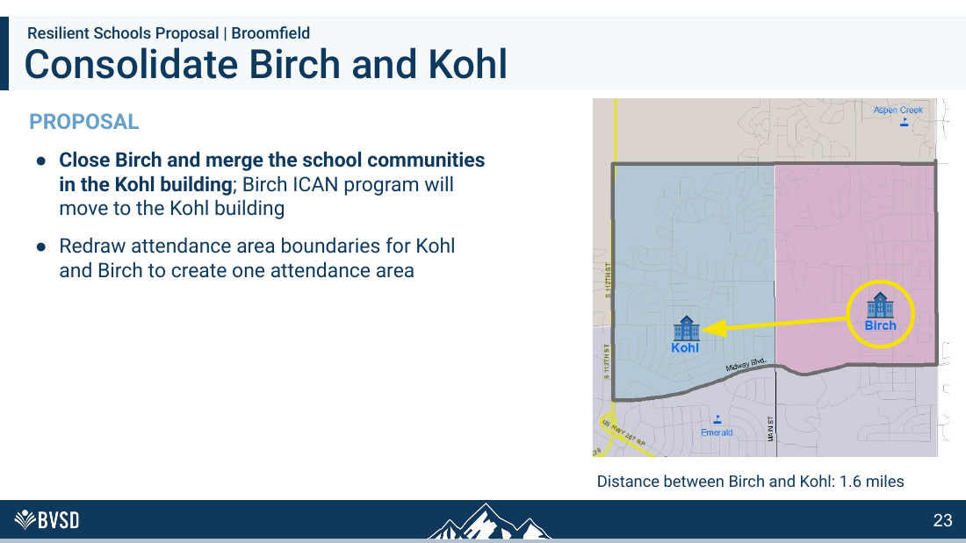
RESPONSE TO BVSD SLIDE 23
Distance alone does not equal access
THE ANSWER
•
1.6 miles can eliminate walking and create daily car dependence.
•
The proposal needs route-level traffic, crossing, bus and family-time analysis.
•
SOLUTION: Publish route-level transportation, crossing and family-time impacts before changing attendance areas.
BVSD’S SLIDE
23 / 75
Notes:
[Sources]
- User-supplied: BVSD Board Union Solutions Brief (September 2, 2026)
- BVSD Collective Bargaining and Staffing Cliffs Board Brief (September 2026)
- BVSD 2026-27 Proposed Budget, School Allocation Formulas
[/Sources]

Slide 26
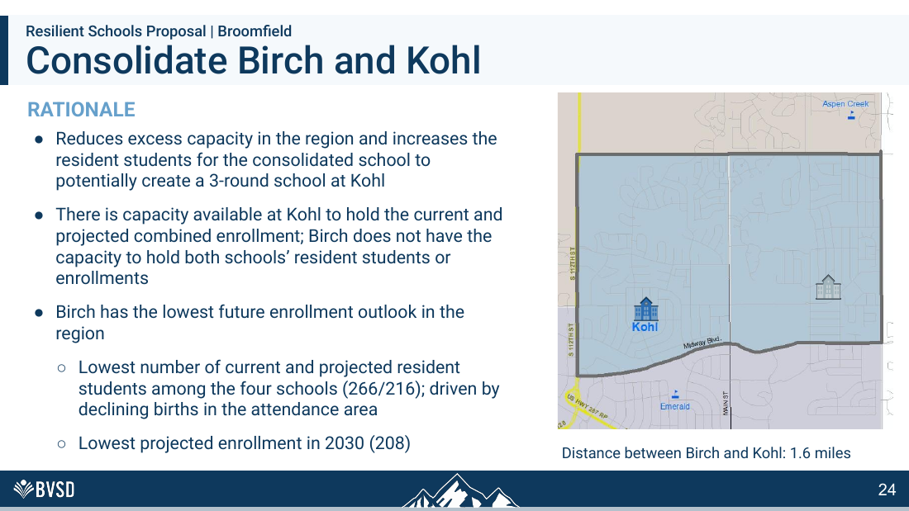
RESPONSE TO BVSD SLIDE 24
The rationale still assumes 450 is ideal
THE ANSWER
•
“Potentially create a 3-round school” is the goal BVSD selected, not an outcome the community selected.
•
Declining births do not prove Birch should lose its school identity.
•
SOLUTION: Test a funded two-round model before converting BVSD’s preferred scale into a closure requirement.
BVSD’S SLIDE
24 / 75
Notes:
[Sources]
- User-supplied: BVSD Board Union Solutions Brief (September 2, 2026)
- BVSD Collective Bargaining and Staffing Cliffs Board Brief (September 2026)
- BVSD 2026-27 Proposed Budget, School Allocation Formulas
[/Sources]

Slide 27
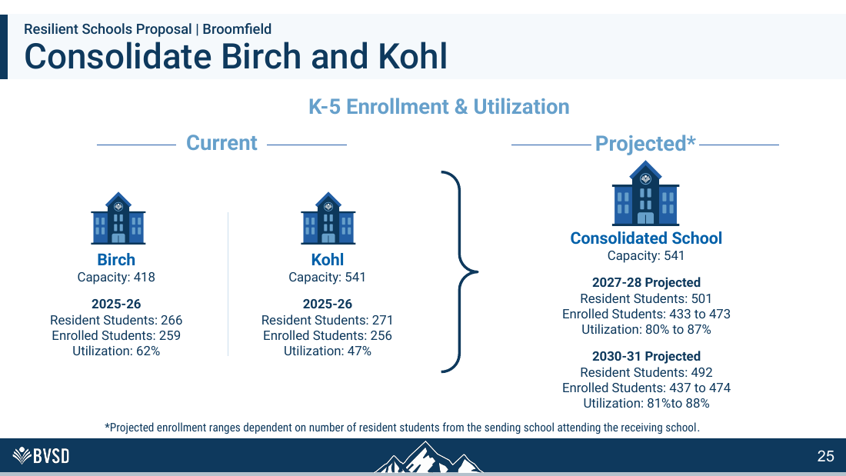
RESPONSE TO BVSD SLIDE 25
80–88% leaves little breathing room
THE ANSWER
•
Kohl would jump from 47% to as high as 88% utilization.
•
That ratio ignores cafeteria throughput, playground crowding, arrival queues and specialized-room needs.
•
SOLUTION: Set school-level operating ceilings for lunch, playground, traffic and support-space demand.
BVSD’S SLIDE
25 / 75
Notes:
[Sources]
- User-supplied: BVSD Board Union Solutions Brief (September 2, 2026)
- BVSD Collective Bargaining and Staffing Cliffs Board Brief (September 2026)
- BVSD 2026-27 Proposed Budget, School Allocation Formulas
[/Sources]

Slide 28
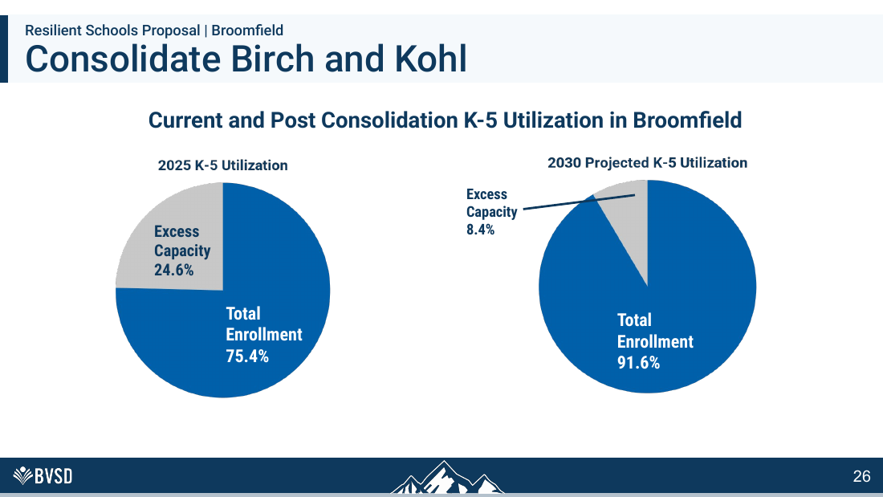
RESPONSE TO BVSD SLIDE 26
91.6% regional use is not resilience
THE ANSWER
•
Near-full utilization eliminates surge space for enrollment shifts, preschool and support programs.
•
It transfers demographic risk from the district to families and staff.
•
SOLUTION: Preserve surge space; resilience requires buffer for enrollment changes and additional programs.
BVSD’S SLIDE
26 / 75
Notes:
[Sources]
- User-supplied: BVSD Board Union Solutions Brief (September 2, 2026)
- BVSD Collective Bargaining and Staffing Cliffs Board Brief (September 2026)
- BVSD 2026-27 Proposed Budget, School Allocation Formulas
[/Sources]

Slide 29
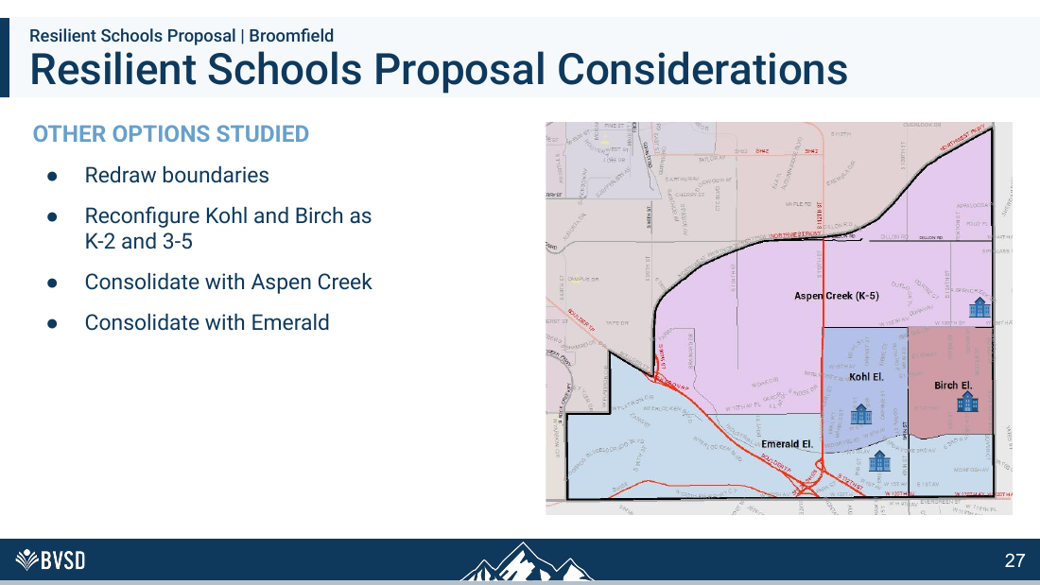
RESPONSE TO BVSD SLIDE 27
“Studied” is not an evaluation
THE ANSWER
•
BVSD lists alternatives without publishing scores, costs, educational effects or reasons for rejection.
•
The Board cannot compare options from a bullet list.
•
SOLUTION: Release the scored alternatives matrix, including staffing-floor and stabilization options.
BVSD’S SLIDE
27 / 75
Notes:
[Sources]
- User-supplied: BVSD Board Union Solutions Brief (September 2, 2026)
- BVSD Collective Bargaining and Staffing Cliffs Board Brief (September 2026)
- BVSD 2026-27 Proposed Budget, School Allocation Formulas
[/Sources]

Slide 30

SOLUTION: Require quantified educational gains and net avoidable savings for every reconfiguration.
Louisville/Superior deserves proof
THE ANSWER
•
Reconfiguration affects children, staff, programs and feeder patterns—not just building charts.
•
The standard must be demonstrated educational gain, not cleaner utilization statistics.
BVSD’S SLIDE
28 / 75
Notes:
[Sources]
- User-supplied: BVSD Board Union Solutions Brief (September 2, 2026)
- BVSD Collective Bargaining and Staffing Cliffs Board Brief (September 2026)
- BVSD 2026-27 Proposed Budget, School Allocation Formulas
[/Sources]

Slide 31
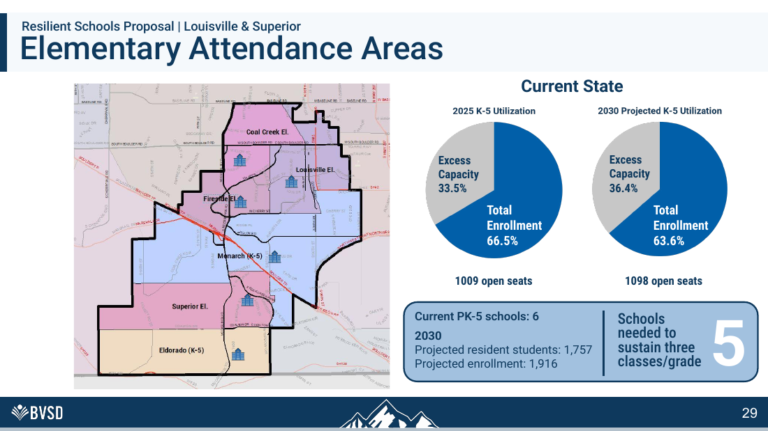
RESPONSE TO BVSD SLIDE 29
Five schools is an assumption
THE ANSWER
•
BVSD again converts the three-round preference into a claimed facility requirement.
•
A 64% regional average does not prove which school configuration is best.
•
SOLUTION: Model shared services and baseline staffing before deciding how many buildings are ‘needed.’
BVSD’S SLIDE
29 / 75
Notes:
[Sources]
- User-supplied: BVSD Board Union Solutions Brief (September 2, 2026)
- BVSD Collective Bargaining and Staffing Cliffs Board Brief (September 2026)
- BVSD 2026-27 Proposed Budget, School Allocation Formulas
[/Sources]

Slide 32
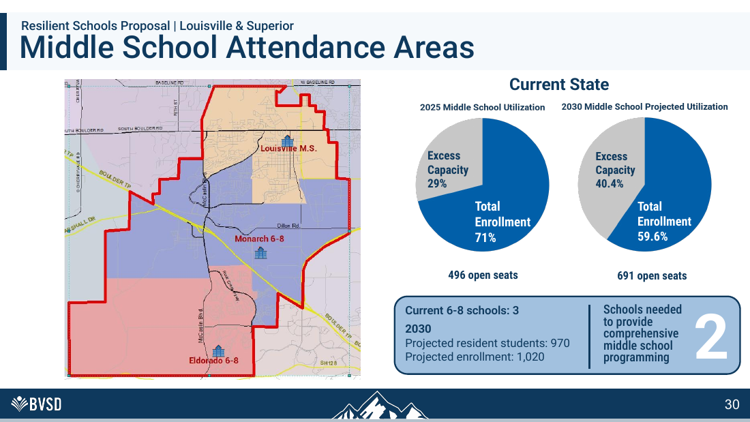
RESPONSE TO BVSD SLIDE 30
The middle-school claim is unsupported
THE ANSWER
•
“Comprehensive” is undefined and not tied to a minimum enrollment in this slide.
•
Courses and supports can be funded directly or shared across campuses.
•
SOLUTION: Fund course access directly or share staff across campuses instead of removing public capacity.
BVSD’S SLIDE
30 / 75
Notes:
[Sources]
- User-supplied: BVSD Board Union Solutions Brief (September 2, 2026)
- BVSD Collective Bargaining and Staffing Cliffs Board Brief (September 2026)
- BVSD 2026-27 Proposed Budget, School Allocation Formulas
[/Sources]

Slide 33
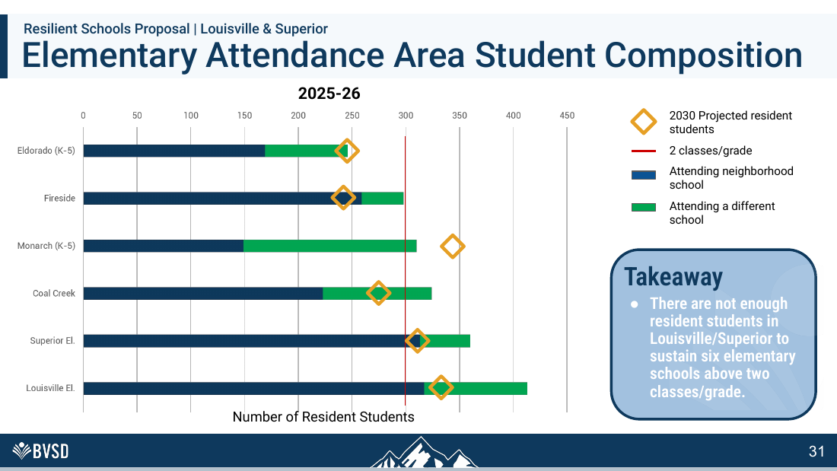
RESPONSE TO BVSD SLIDE 31
Two rounds hit a formula breakpoint—not an educational wall
THE ANSWER
•
BVEA’s specialist table jumps at section bands; that cliff can be replaced through bargaining with continuous minutes-based FTE.
•
Board-controlled counselor, librarian and administrative bands can be smoothed immediately through the budget.
•
SOLUTION: Replace section stair-steps with smooth fractional FTE and a one-year stabilization pool.
BVSD’S SLIDE
31 / 75
Notes:
[Sources]
- User-supplied: BVSD Board Union Solutions Brief (September 2, 2026)
- BVSD Collective Bargaining and Staffing Cliffs Board Brief (September 2026)
- BVSD 2026-27 Proposed Budget, School Allocation Formulas
[/Sources]

Slide 34
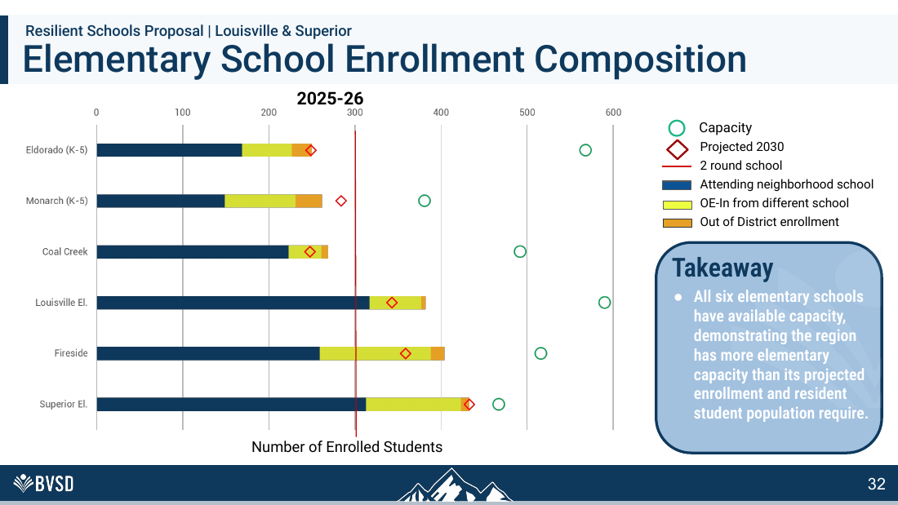
RESPONSE TO BVSD SLIDE 32
Available capacity is a feature
THE ANSWER
•
Open space can keep classes smaller and support specialized instruction.
•
The chart never measures lunch congestion, pickup, safety or belonging.
•
SOLUTION: Convert available rooms to preschool, intervention, special education and community uses before closure.
BVSD’S SLIDE
32 / 75
Notes:
[Sources]
- User-supplied: BVSD Board Union Solutions Brief (September 2, 2026)
- BVSD Collective Bargaining and Staffing Cliffs Board Brief (September 2026)
- BVSD 2026-27 Proposed Budget, School Allocation Formulas
[/Sources]

Slide 35
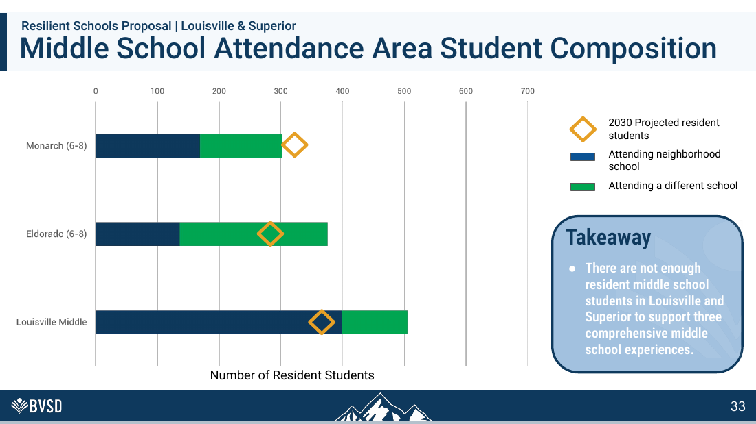
RESPONSE TO BVSD SLIDE 33
“Not enough” depends on the model
THE ANSWER
•
There may be fewer students than BVSD wants for three conventional campuses, but that is not proof three communities cannot be served.
•
Evaluate small-school and shared-service models first.
•
SOLUTION: Guarantee a principal and functional front office at every operating school, regardless of headcount.
BVSD’S SLIDE
33 / 75
Notes:
[Sources]
- User-supplied: BVSD Board Union Solutions Brief (September 2, 2026)
- BVSD Collective Bargaining and Staffing Cliffs Board Brief (September 2026)
- BVSD 2026-27 Proposed Budget, School Allocation Formulas
[/Sources]

Slide 36
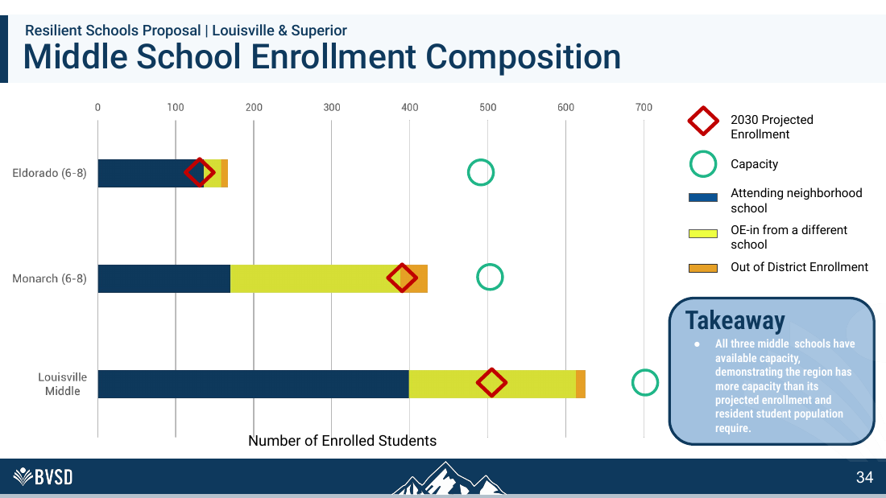
RESPONSE TO BVSD SLIDE 34
Choice patterns can change
THE ANSWER
•
Current enrollment composition reflects program locations, boundaries and transportation policy.
•
BVSD should not treat its own policy-driven patterns as immutable demand.
•
SOLUTION: Use weighted need—IEPs, mobility, multilingual learners and program complexity—not raw enrollment alone.
BVSD’S SLIDE
34 / 75
Notes:
[Sources]
- User-supplied: BVSD Board Union Solutions Brief (September 2, 2026)
- BVSD Collective Bargaining and Staffing Cliffs Board Brief (September 2026)
- BVSD 2026-27 Proposed Budget, School Allocation Formulas
[/Sources]

Slide 37
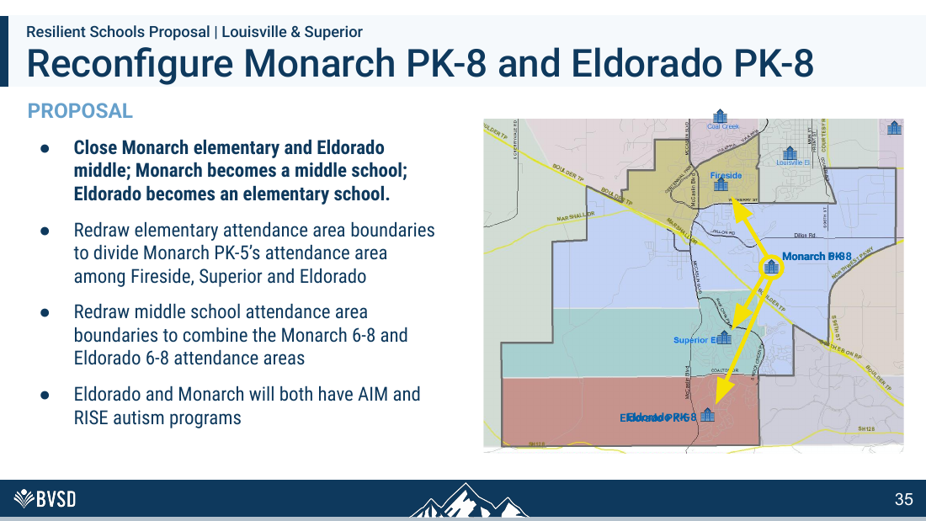
RESPONSE TO BVSD SLIDE 35
Reconfiguration trades continuity for scale
THE ANSWER
•
Children lose a PK-8 pathway and familiar cross-grade community.
•
Moving autism programs requires a detailed sensory, staffing and transition analysis.
•
SOLUTION: Test retention investments and program guarantees before making enrollment patterns permanent.
BVSD’S SLIDE
35 / 75
Notes:
[Sources]
- User-supplied: BVSD Board Union Solutions Brief (September 2, 2026)
- BVSD Collective Bargaining and Staffing Cliffs Board Brief (September 2026)
- BVSD 2026-27 Proposed Budget, School Allocation Formulas
[/Sources]

Slide 38
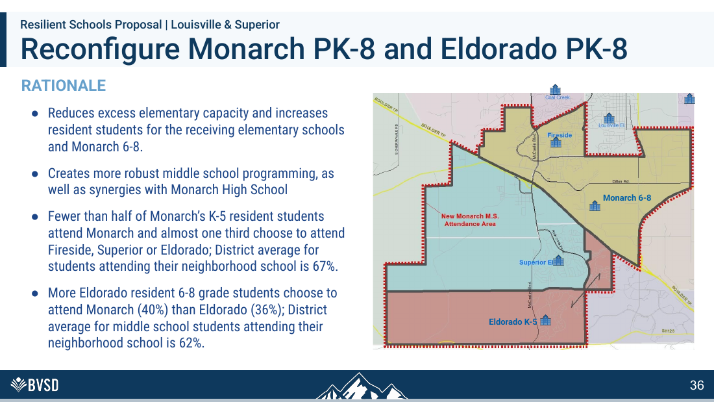
RESPONSE TO BVSD SLIDE 36
“Synergy” is not a measurable outcome
THE ANSWER
•
Proximity to Monarch High does not guarantee access to courses or staff.
•
Current choice behavior does not prove families prefer losing the PK-8 model.
•
SOLUTION: Negotiate follow-the-program protections and preserve teams when specialized programs move.
BVSD’S SLIDE
36 / 75
Notes:
[Sources]
- User-supplied: BVSD Board Union Solutions Brief (September 2, 2026)
- BVSD Collective Bargaining and Staffing Cliffs Board Brief (September 2026)
- BVSD 2026-27 Proposed Budget, School Allocation Formulas
[/Sources]

Slide 39
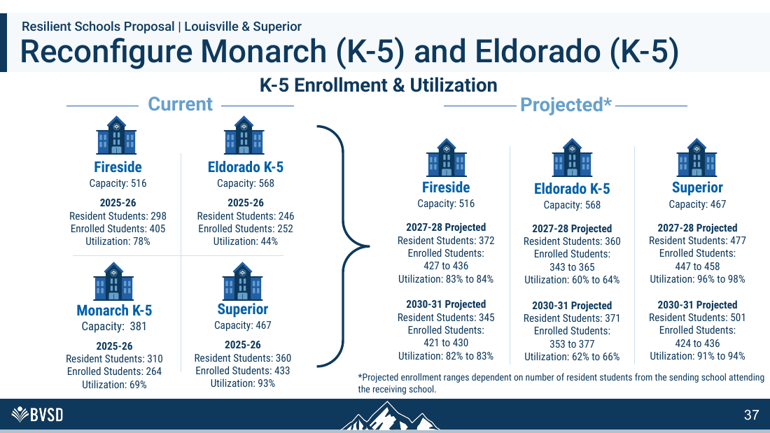
RESPONSE TO BVSD SLIDE 37
A 98% elementary school is overcrowded
THE ANSWER
•
Superior is projected at 96–98% utilization in 2027–28.
•
That leaves almost no operational buffer and invites crowded shared spaces and class-size pressure.
•
SOLUTION: Specify the programs, staffing, schedules and guaranteed access before approving reconfiguration.
BVSD’S SLIDE
37 / 75
Notes:
[Sources]
- User-supplied: BVSD Board Union Solutions Brief (September 2, 2026)
- BVSD Collective Bargaining and Staffing Cliffs Board Brief (September 2026)
- BVSD 2026-27 Proposed Budget, School Allocation Formulas
[/Sources]

Slide 40
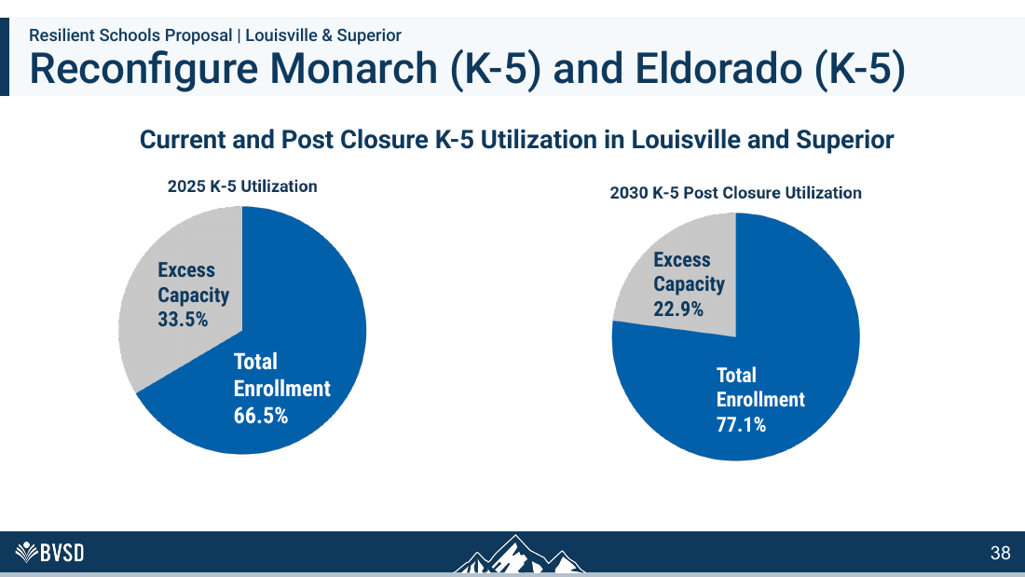
RESPONSE TO BVSD SLIDE 38
The average hides the hotspot
THE ANSWER
•
Regional utilization improves to 77.1%, but Superior approaches 98%.
•
Averages conceal exactly where children will experience crowding.
•
SOLUTION: Adopt a school-level utilization ceiling and retain buffer for student support and forecast error.
BVSD’S SLIDE
38 / 75
Notes:
[Sources]
- User-supplied: BVSD Board Union Solutions Brief (September 2, 2026)
- BVSD Collective Bargaining and Staffing Cliffs Board Brief (September 2026)
- BVSD 2026-27 Proposed Budget, School Allocation Formulas
[/Sources]

Slide 41
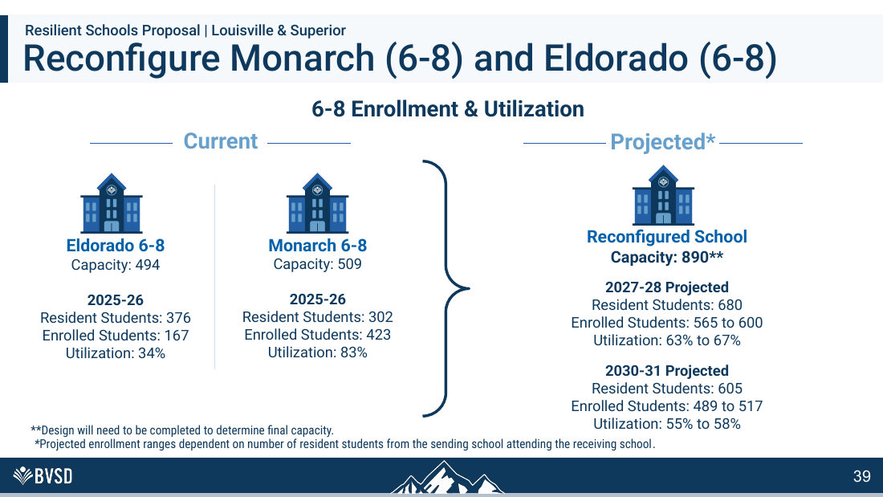
RESPONSE TO BVSD SLIDE 39
The middle school remains underused
THE ANSWER
•
The reconfigured Monarch school is projected at only 55–67% utilization.
•
If underutilization justifies closure elsewhere, this result contradicts BVSD’s own logic.
•
SOLUTION: Publish school-level impacts; a regional average cannot excuse crowding at one receiving school.
BVSD’S SLIDE
39 / 75
Notes:
[Sources]
- User-supplied: BVSD Board Union Solutions Brief (September 2, 2026)
- BVSD Collective Bargaining and Staffing Cliffs Board Brief (September 2026)
- BVSD 2026-27 Proposed Budget, School Allocation Formulas
[/Sources]

Slide 42
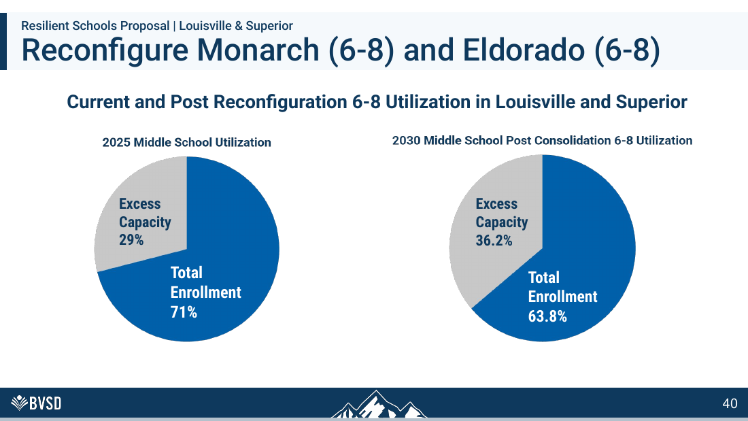
RESPONSE TO BVSD SLIDE 40
This chart moves backward
THE ANSWER
•
Middle-school utilization falls from 71% to 63.8% after reconfiguration.
•
BVSD cannot sell consolidation as efficiency while displaying a worse utilization result.
•
SOLUTION: Compare the result with a baseline-funded no-reconfiguration option before disrupting two communities.
BVSD’S SLIDE
40 / 75
Notes:
[Sources]
- User-supplied: BVSD Board Union Solutions Brief (September 2, 2026)
- BVSD Collective Bargaining and Staffing Cliffs Board Brief (September 2026)
- BVSD 2026-27 Proposed Budget, School Allocation Formulas
[/Sources]

Slide 43
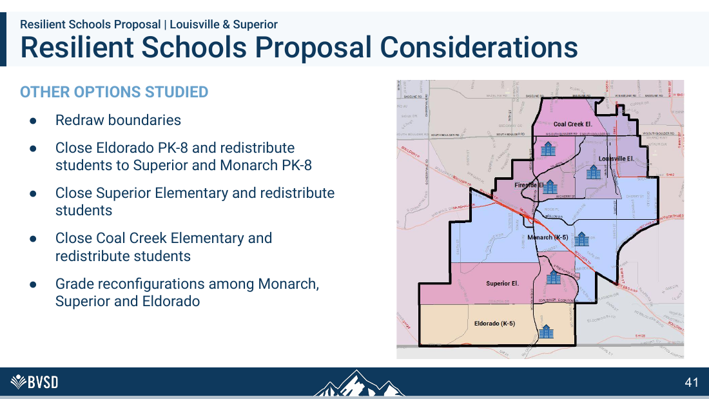
RESPONSE TO BVSD SLIDE 41
Release the rejected-option record
THE ANSWER
•
The list omits comparative costs, community preferences and student impacts.
•
Some options close different schools; the selection criteria must be transparent.
•
SOLUTION: Reject any option that worsens the district’s own utilization metric without a proven educational gain.
BVSD’S SLIDE
41 / 75
Notes:
[Sources]
- User-supplied: BVSD Board Union Solutions Brief (September 2, 2026)
- BVSD Collective Bargaining and Staffing Cliffs Board Brief (September 2026)
- BVSD 2026-27 Proposed Budget, School Allocation Formulas
[/Sources]

Slide 44

SOLUTION: Release comparative costs, criteria and student impacts for every rejected alternative.
Boulder’s schools are civic infrastructure
THE ANSWER
•
The relevant question is not how few buildings can hold the children.
•
It is what network of schools best serves neighborhoods over decades.
BVSD’S SLIDE
42 / 75
Notes:
[Sources]
- User-supplied: BVSD Board Union Solutions Brief (September 2, 2026)
- BVSD Collective Bargaining and Staffing Cliffs Board Brief (September 2026)
- BVSD 2026-27 Proposed Budget, School Allocation Formulas
[/Sources]

Slide 45
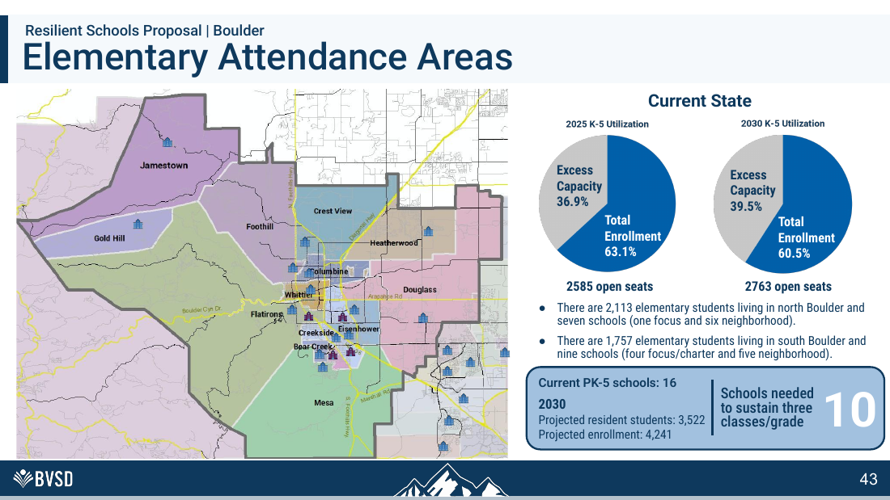
RESPONSE TO BVSD SLIDE 43
“Ten schools needed” is manufactured
THE ANSWER
•
BVSD obtains ten by dividing enrollment by its preferred three-round scale.
•
Four focus/charter schools in south Boulder serve distinct missions; they are not interchangeable seats.
•
SOLUTION: Treat schools as long-lived civic infrastructure and fund the network for service, not maximum occupancy.
BVSD’S SLIDE
43 / 75
Notes:
[Sources]
- User-supplied: BVSD Board Union Solutions Brief (September 2, 2026)
- BVSD Collective Bargaining and Staffing Cliffs Board Brief (September 2026)
- BVSD 2026-27 Proposed Budget, School Allocation Formulas
[/Sources]

Slide 46
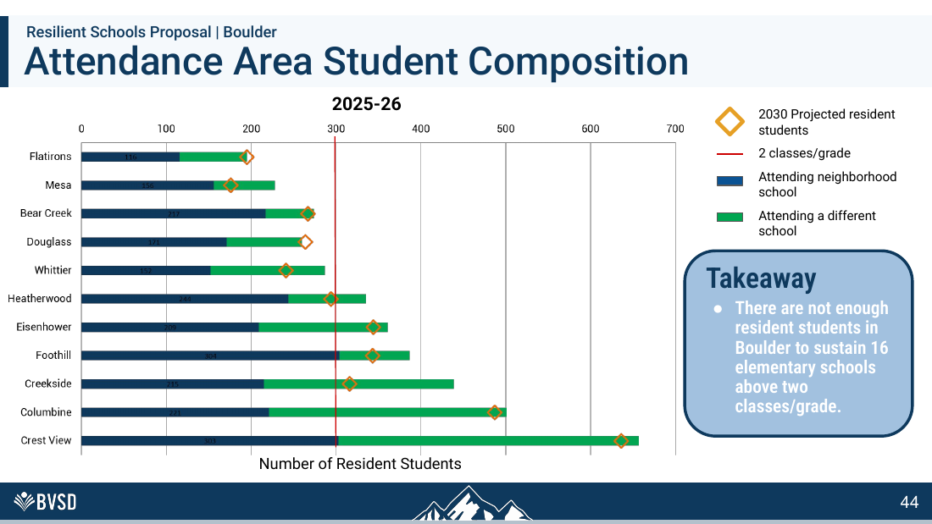
RESPONSE TO BVSD SLIDE 44
Residence is not enrollment
THE ANSWER
•
The analysis discounts open enrollment, focus programs and families BVSD could retain or attract.
•
A boundary address is not a measure of school value.
•
SOLUTION: Stop dividing enrollment by a preferred school size; price the actual staff needed at each open building.
BVSD’S SLIDE
44 / 75
Notes:
[Sources]
- User-supplied: BVSD Board Union Solutions Brief (September 2, 2026)
- BVSD Collective Bargaining and Staffing Cliffs Board Brief (September 2026)
- BVSD 2026-27 Proposed Budget, School Allocation Formulas
[/Sources]

Slide 47
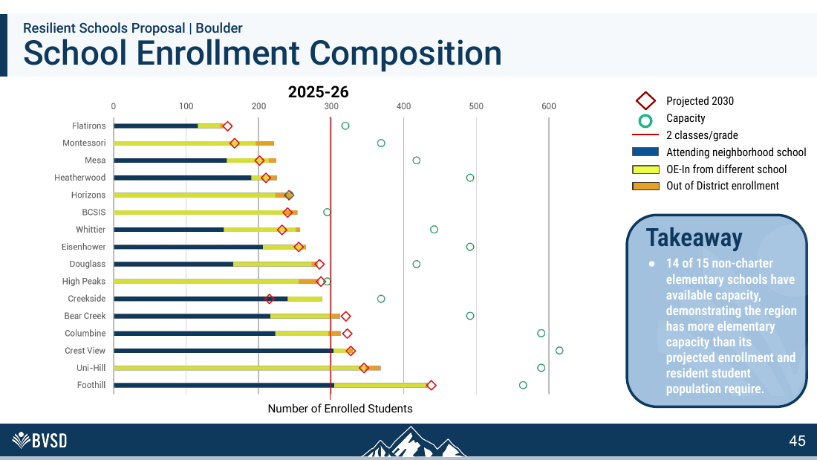
RESPONSE TO BVSD SLIDE 45
Fourteen buildings with space is not a crisis
THE ANSWER
•
Available capacity can deliver the small classes families explicitly requested.
•
BVSD never shows that empty rooms materially degrade achievement.
•
SOLUTION: Count actual demand and program value, then use boundaries and transportation to improve enrollment balance.
BVSD’S SLIDE
45 / 75
Notes:
[Sources]
- User-supplied: BVSD Board Union Solutions Brief (September 2, 2026)
- BVSD Collective Bargaining and Staffing Cliffs Board Brief (September 2026)
- BVSD 2026-27 Proposed Budget, School Allocation Formulas
[/Sources]

Slide 48
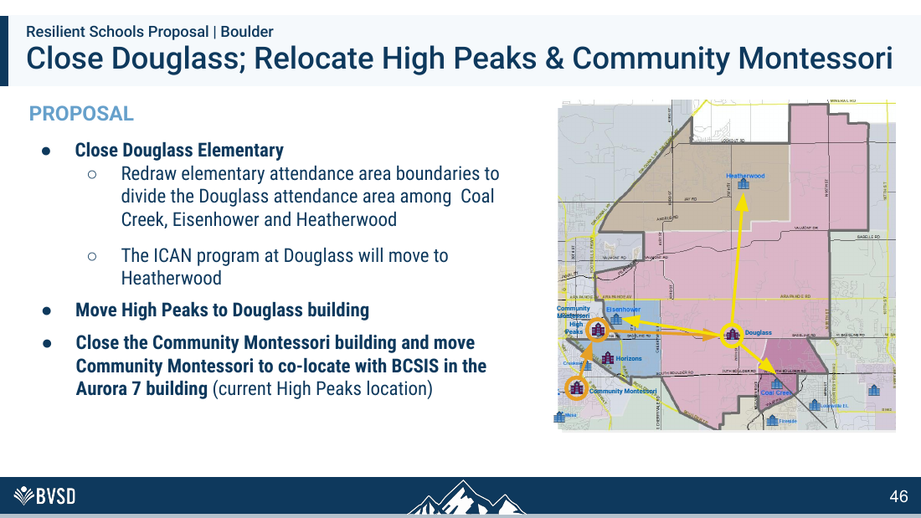
RESPONSE TO BVSD SLIDE 46
A four-school domino chain is excessive
THE ANSWER
•
Closing Douglass triggers relocations of High Peaks and Community Montessori and co-location with BCSIS.
•
That multiplies disruption far beyond one attendance area.
•
SOLUTION: Use unused rooms for student and community services before declaring a functioning school surplus.
BVSD’S SLIDE
46 / 75
Notes:
[Sources]
- User-supplied: BVSD Board Union Solutions Brief (September 2, 2026)
- BVSD Collective Bargaining and Staffing Cliffs Board Brief (September 2026)
- BVSD 2026-27 Proposed Budget, School Allocation Formulas
[/Sources]

Slide 49
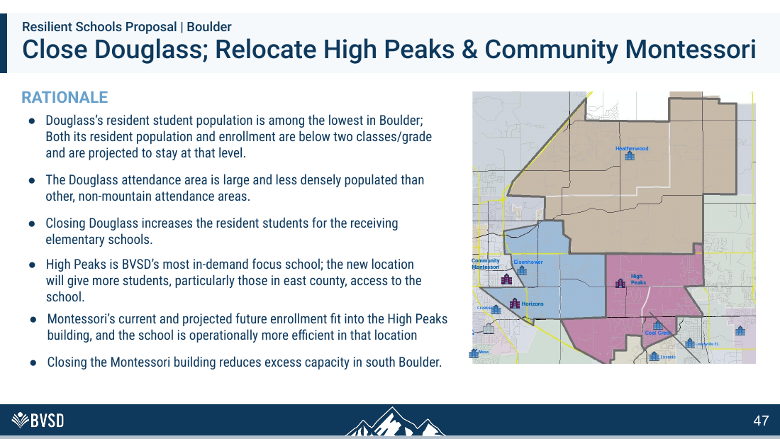
RESPONSE TO BVSD SLIDE 47
Demand for High Peaks does not condemn Douglass
THE ANSWER
•
High Peaks’ popularity is an argument for expansion—not an argument that Douglass must disappear.
•
The proposal uses one school’s demand to rationalize upheaval at several others.
•
SOLUTION: Expand high-demand programs without closure by using open rooms, phased moves or shared-campus options.
BVSD’S SLIDE
47 / 75
Notes:
[Sources]
- User-supplied: BVSD Board Union Solutions Brief (September 2, 2026)
- BVSD Collective Bargaining and Staffing Cliffs Board Brief (September 2026)
- BVSD 2026-27 Proposed Budget, School Allocation Formulas
[/Sources]

Slide 50
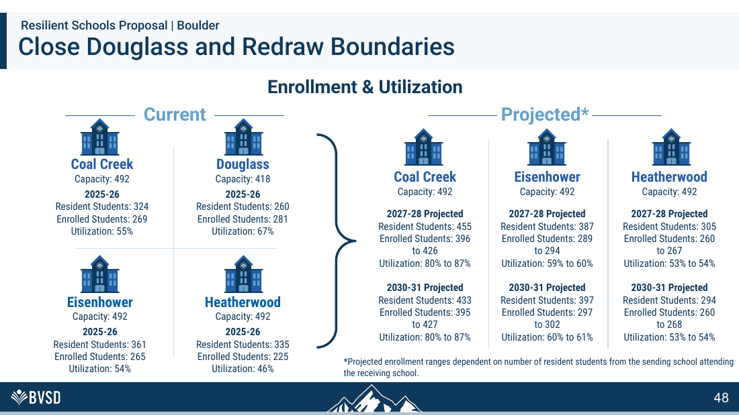
RESPONSE TO BVSD SLIDE 48
Closure does not achieve the stated model
THE ANSWER
•
After Douglass closes, Heatherwood remains only 53–54% utilized and Eisenhower 60–61%.
•
The plan does not create three-round schools everywhere; it merely moves students.
•
SOLUTION: Publish net benefit and transition risk for each affected community before using demand to displace a school.
BVSD’S SLIDE
48 / 75
Notes:
[Sources]
- User-supplied: BVSD Board Union Solutions Brief (September 2, 2026)
- BVSD Collective Bargaining and Staffing Cliffs Board Brief (September 2026)
- BVSD 2026-27 Proposed Budget, School Allocation Formulas
[/Sources]

Slide 51
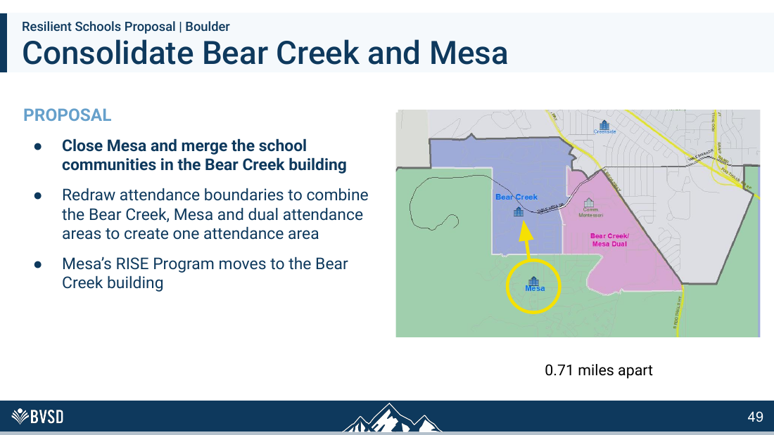
RESPONSE TO BVSD SLIDE 49
0.71 miles is not the whole experience
THE ANSWER
•
Distance does not measure safe walking routes, pickup queues, accessibility or community identity.
•
Combining AIM and RISE populations requires program-specific space and staffing proof.
•
SOLUTION: Fund minimum staffing floors instead of moving children merely to reach the three-round target.
BVSD’S SLIDE
49 / 75
Notes:
[Sources]
- User-supplied: BVSD Board Union Solutions Brief (September 2, 2026)
- BVSD Collective Bargaining and Staffing Cliffs Board Brief (September 2026)
- BVSD 2026-27 Proposed Budget, School Allocation Formulas
[/Sources]

Slide 52
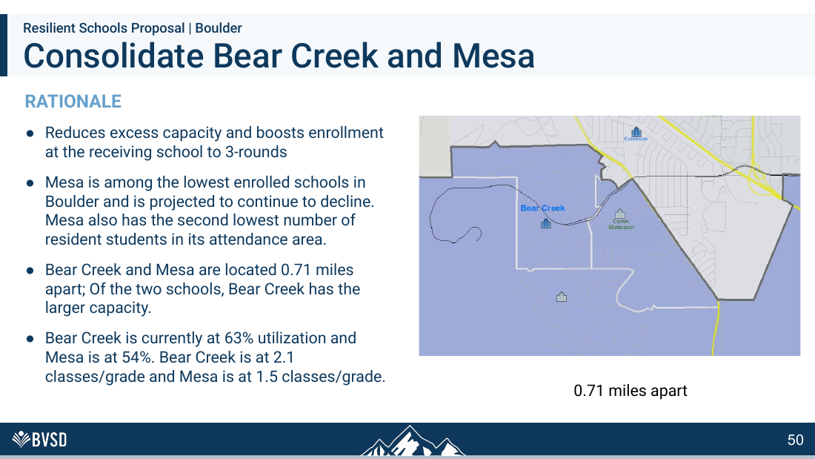
RESPONSE TO BVSD SLIDE 50
“Boosts enrollment” is not a student outcome
THE ANSWER
•
The rationale celebrates a larger headcount without showing better achievement, wellbeing or service quality.
•
Bear Creek at 80–94% may face crowded commons and little flexibility.
•
SOLUTION: Require program-specific space, sensory, staffing and continuity guarantees before any relocation.
BVSD’S SLIDE
50 / 75
Notes:
[Sources]
- User-supplied: BVSD Board Union Solutions Brief (September 2, 2026)
- BVSD Collective Bargaining and Staffing Cliffs Board Brief (September 2026)
- BVSD 2026-27 Proposed Budget, School Allocation Formulas
[/Sources]

Slide 53
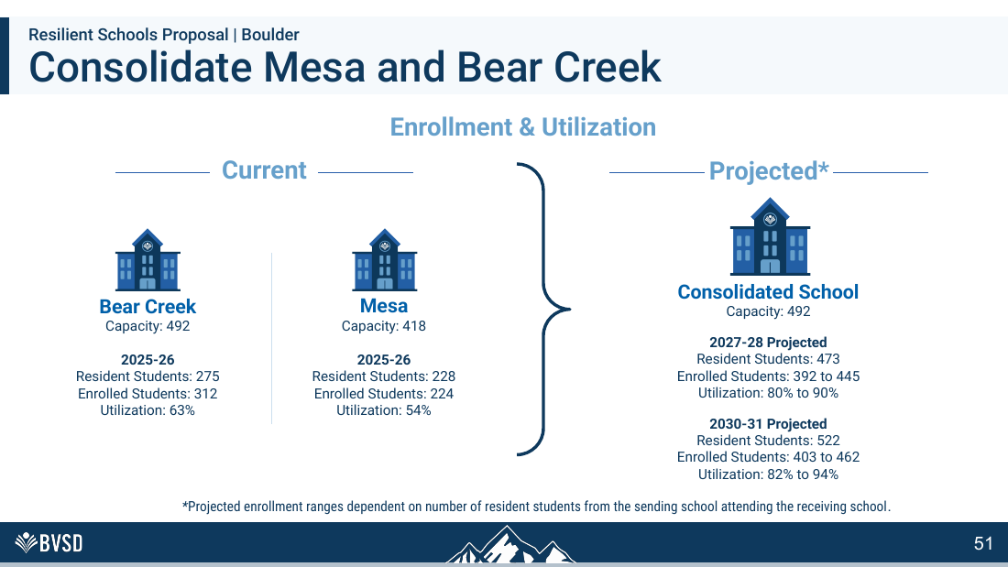
RESPONSE TO BVSD SLIDE 51
The high-end scenario is nearly full
THE ANSWER
•
Bear Creek could reach 94% utilization by 2030–31.
•
That leaves minimal space for program growth, support rooms or forecast error.
•
SOLUTION: Simulate lunch, recess, arrival and dismissal at the proposed enrollment before approving consolidation.
BVSD’S SLIDE
51 / 75
Notes:
[Sources]
- User-supplied: BVSD Board Union Solutions Brief (September 2, 2026)
- BVSD Collective Bargaining and Staffing Cliffs Board Brief (September 2026)
- BVSD 2026-27 Proposed Budget, School Allocation Formulas
[/Sources]

Slide 54
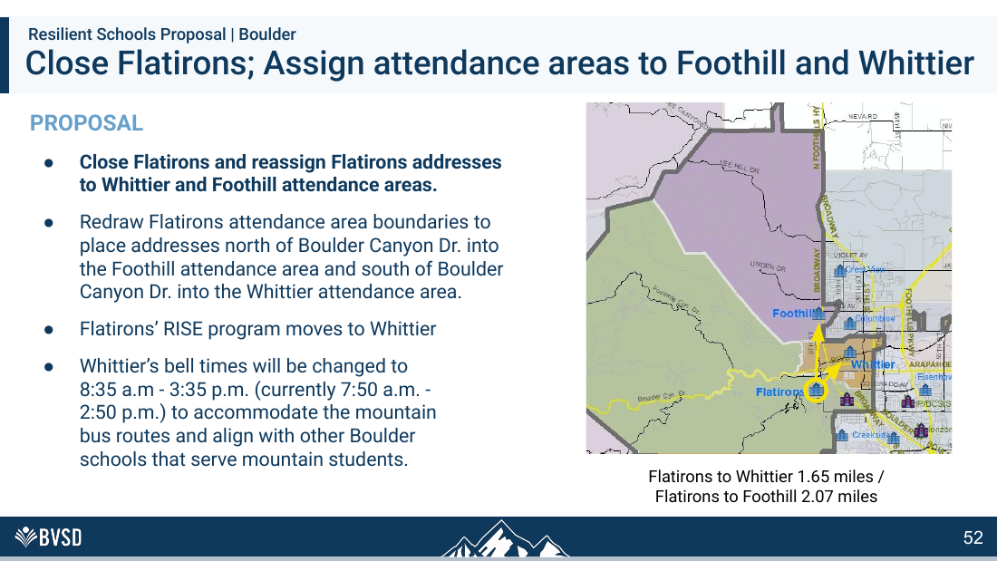
RESPONSE TO BVSD SLIDE 52
Flatirons families lose their school
THE ANSWER
•
Students are split between two communities instead of preserving their own.
•
Crossing Boulder Canyon and changing Whittier’s bell time impose costs on families not captured in enrollment charts.
•
SOLUTION: Cap receiving-school utilization and preserve rooms for intervention, special education and growth.
BVSD’S SLIDE
52 / 75
Notes:
[Sources]
- User-supplied: BVSD Board Union Solutions Brief (September 2, 2026)
- BVSD Collective Bargaining and Staffing Cliffs Board Brief (September 2026)
- BVSD 2026-27 Proposed Budget, School Allocation Formulas
[/Sources]

Slide 55
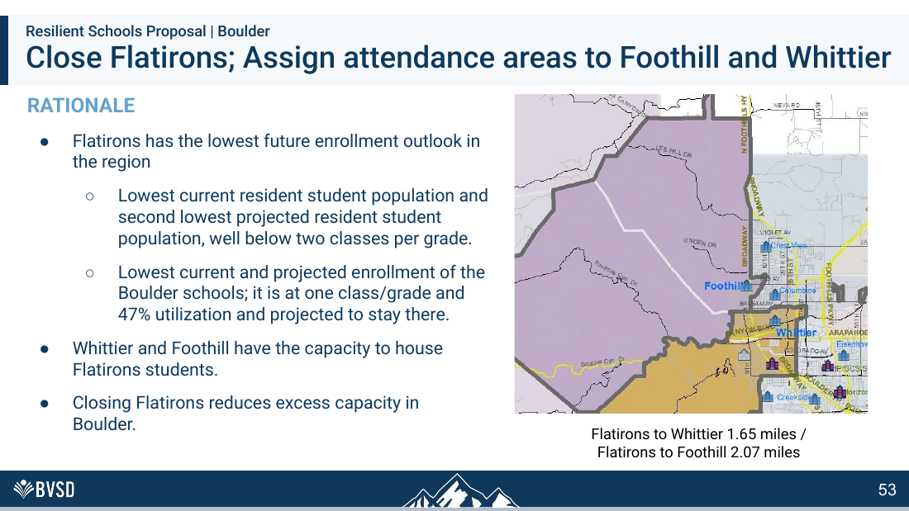
RESPONSE TO BVSD SLIDE 53
Flatirons is being punished by the allocation system
THE ANSWER
•
Low enrollment reduces staffing under BVSD’s formulas, then the resulting service gaps are cited as proof the school is too small.
•
No identified CBA clause requires Flatirons to close; baseline staffing would break that circular logic.
•
SOLUTION: Keep Flatirons open under baseline-plus-variable staffing and a three-year enrollment average.
BVSD’S SLIDE
53 / 75
Notes:
[Sources]
- User-supplied: BVSD Board Union Solutions Brief (September 2, 2026)
- BVSD Collective Bargaining and Staffing Cliffs Board Brief (September 2026)
- BVSD 2026-27 Proposed Budget, School Allocation Formulas
[/Sources]

Slide 56
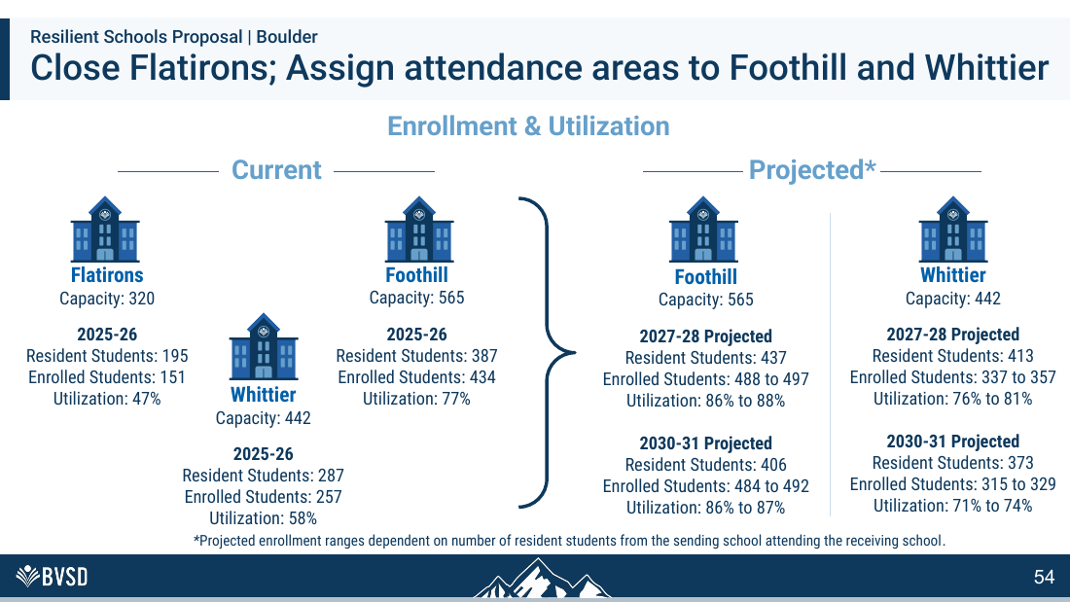
RESPONSE TO BVSD SLIDE 54
“It fits” is not good enough
THE ANSWER
•
Foothill rises to 488–497 students; Whittier rises from 257 to as many as 357.
•
Those increases affect every lunch, recess, hallway, pickup and dismissal—not merely classrooms.
•
SOLUTION: Replace the one-class-per-grade penalty with a funded building baseline and continuous specialist FTE.
BVSD’S SLIDE
54 / 75
Notes:
[Sources]
- User-supplied: BVSD Board Union Solutions Brief (September 2, 2026)
- BVSD Collective Bargaining and Staffing Cliffs Board Brief (September 2026)
- BVSD 2026-27 Proposed Budget, School Allocation Formulas
[/Sources]

Slide 57
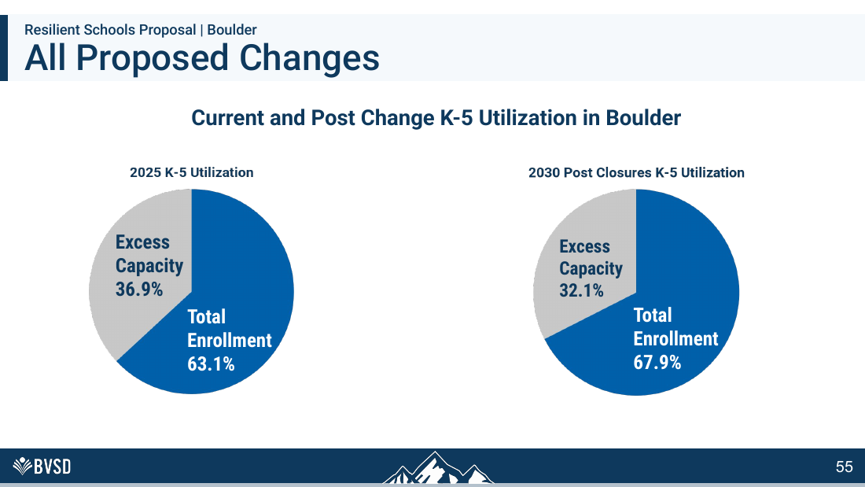
RESPONSE TO BVSD SLIDE 55
Huge disruption buys 4.8 points
THE ANSWER
•
Boulder utilization rises only from 63.1% to 67.9%; 32.1% of seats remain empty.
•
That is a modest dent after closures, relocations and boundary changes affecting thousands.
•
SOLUTION: Require operational simulations and school-level enrollment ceilings—not paper capacity alone.
BVSD’S SLIDE
55 / 75
Notes:
[Sources]
- User-supplied: BVSD Board Union Solutions Brief (September 2, 2026)
- BVSD Collective Bargaining and Staffing Cliffs Board Brief (September 2026)
- BVSD 2026-27 Proposed Budget, School Allocation Formulas
[/Sources]

Slide 58
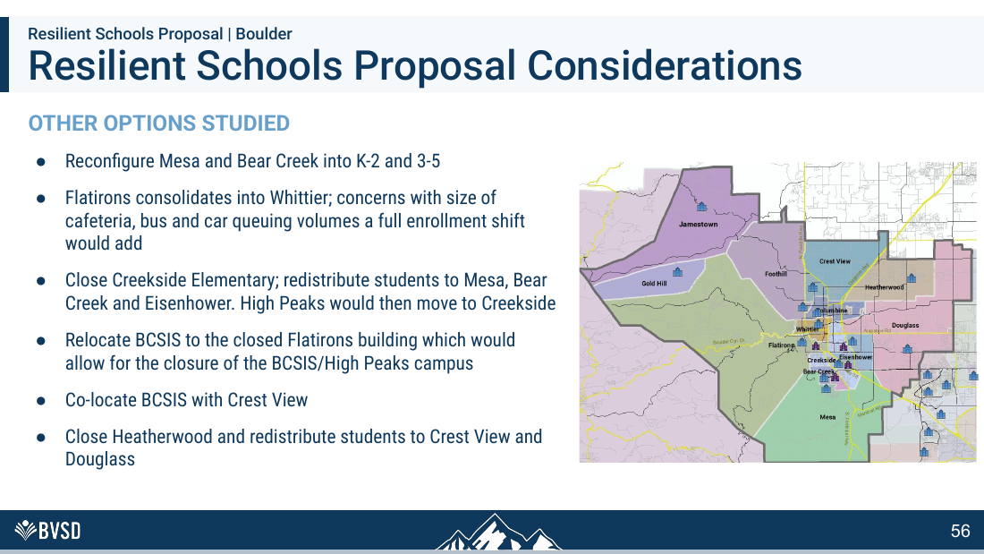
RESPONSE TO BVSD SLIDE 56
BVSD admits capacity is misleading
THE ANSWER
•
BVSD rejected moving all Flatirons students to Whittier because of cafeteria size and bus/car queuing.
•
That admission proves a building’s stated capacity is not the same as a functional, child-centered school.
•
SOLUTION: Use BVSD’s own cafeteria and queuing concerns to set functional-capacity limits for every receiving school.
BVSD’S SLIDE
56 / 75
Notes:
[Sources]
- User-supplied: BVSD Board Union Solutions Brief (September 2, 2026)
- BVSD Collective Bargaining and Staffing Cliffs Board Brief (September 2026)
- BVSD 2026-27 Proposed Budget, School Allocation Formulas
[/Sources]

Slide 59

SOLUTION: Evaluate each school’s civic and educational value—not only the districtwide seat total.
Six closures are not a summary statistic
THE ANSWER
•
Each closure destroys a distinct institution, relationship network and neighborhood anchor.
•
The district should evaluate human and civic loss with the same seriousness as seat counts.
BVSD’S SLIDE
57 / 75
Notes:
[Sources]
- User-supplied: BVSD Board Union Solutions Brief (September 2, 2026)
- BVSD Collective Bargaining and Staffing Cliffs Board Brief (September 2026)
- BVSD 2026-27 Proposed Budget, School Allocation Formulas
[/Sources]

Slide 60
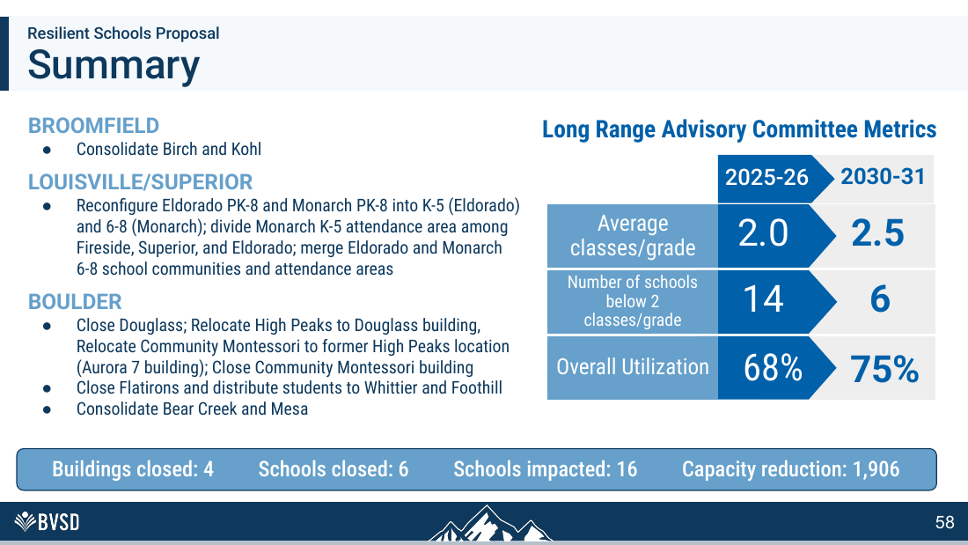
RESPONSE TO BVSD SLIDE 58
The headline numbers indict the plan
THE ANSWER
•
Six schools close and 16 are affected to move utilization only seven points—from 68% to 75%.
•
Boulder still has nearly one-third empty seats afterward.
•
SOLUTION: Condition any action on measurable school-level benefits, not a seven-point district average.
BVSD’S SLIDE
58 / 75
Notes:
[Sources]
- User-supplied: BVSD Board Union Solutions Brief (September 2, 2026)
- BVSD Collective Bargaining and Staffing Cliffs Board Brief (September 2026)
- BVSD 2026-27 Proposed Budget, School Allocation Formulas
[/Sources]

Slide 61
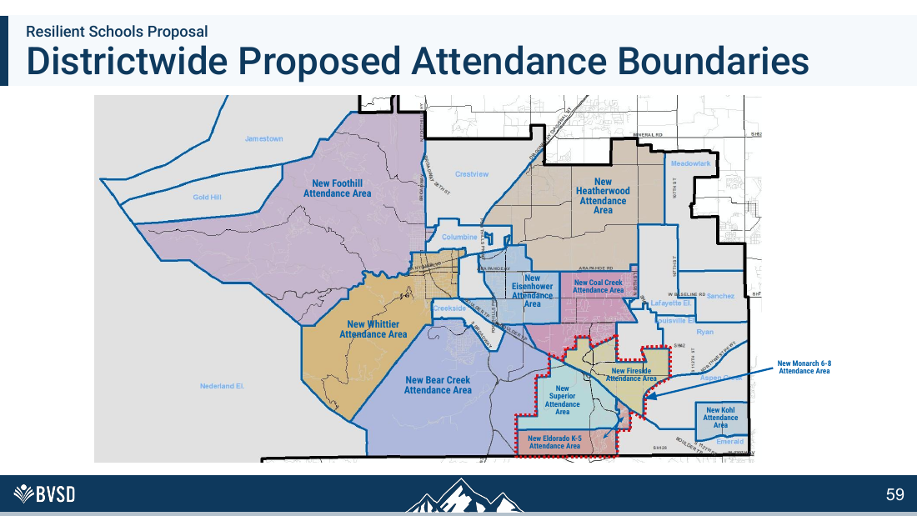
RESPONSE TO BVSD SLIDE 59
A map hides the daily burden
THE ANSWER
•
New boundaries do not show drive times, dangerous crossings, bus duration, congestion or lost walkability.
•
Publish route-level impact maps for every affected address.
•
SOLUTION: Publish route-level travel, safety, bus-duration and congestion analysis for every affected address.
BVSD’S SLIDE
59 / 75
Notes:
[Sources]
- User-supplied: BVSD Board Union Solutions Brief (September 2, 2026)
- BVSD Collective Bargaining and Staffing Cliffs Board Brief (September 2026)
- BVSD 2026-27 Proposed Budget, School Allocation Formulas
[/Sources]

Slide 62
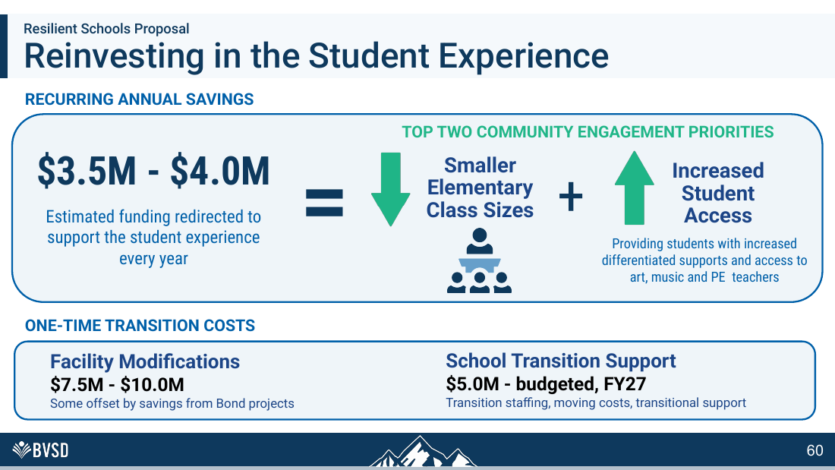
RESPONSE TO BVSD SLIDE 60
The savings case ignores the cost of staffing cliffs
THE ANSWER
•
$3.5-$4.0M is about 0.8-0.9% of operating revenue, before transferred and transition costs.
•
BVSD has not published what baseline staffing, buffers and a stabilization reserve would cost by comparison.
•
SOLUTION: Identify true avoidable savings and compare them with a stabilization reserve and baseline staffing cost.
BVSD’S SLIDE
60 / 75
Notes:
[Sources]
- User-supplied: BVSD Board Union Solutions Brief (September 2, 2026)
- BVSD Collective Bargaining and Staffing Cliffs Board Brief (September 2026)
- BVSD 2026-27 Proposed Budget, School Allocation Formulas
[/Sources]

Slide 63

RESPONSE TO BVSD SLIDE 61
The Board has immediate alternatives
THE ANSWER
•
Principal, office, librarian, health and many counselor thresholds are budget formulas the Board can change now.
•
The remaining contractual cliffs can be handled through targeted bargaining rather than building closure.
•
SOLUTION: Use the $65.6M operating-fund balance carefully for one-year stabilization while permanent reforms are tested.
BVSD’S SLIDE
61 / 75
Notes:
[Sources]
- User-supplied: BVSD Board Union Solutions Brief (September 2, 2026)
- BVSD Collective Bargaining and Staffing Cliffs Board Brief (September 2026)
- BVSD 2026-27 Proposed Budget, School Allocation Formulas
[/Sources]

Slide 64

SOLUTION: Do not vote until BVSD identifies which contract clauses require closure; none identified so far does.
Transition language cannot erase loss
THE ANSWER
•
A smooth closure is still a closure.
•
Support plans should not be used as evidence that the underlying decision is educationally sound.
BVSD’S SLIDE
62 / 75
Notes:
[Sources]
- User-supplied: BVSD Board Union Solutions Brief (September 2, 2026)
- BVSD Collective Bargaining and Staffing Cliffs Board Brief (September 2026)
- BVSD 2026-27 Proposed Budget, School Allocation Formulas
[/Sources]

Slide 65
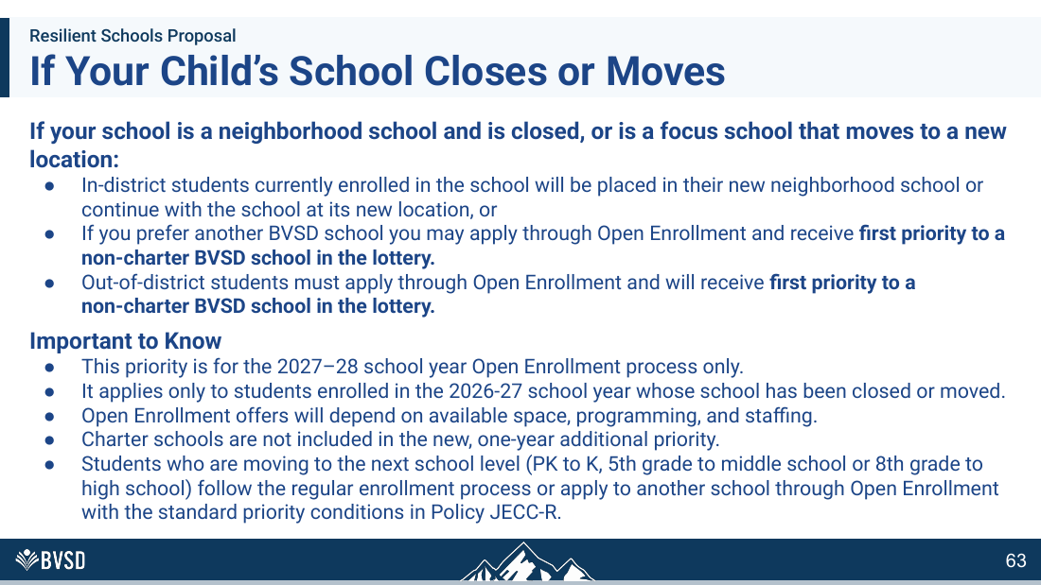
RESPONSE TO BVSD SLIDE 63
One-year priority is not continuity
THE ANSWER
•
Open-enrollment priority lasts only for 2027–28 and remains contingent on space, programming and staffing.
•
Families cannot count on siblings or long-term placement.
•
SOLUTION: Make sibling, program and long-term placement guarantees binding—not a one-year preference.
BVSD’S SLIDE
63 / 75
Notes:
[Sources]
- User-supplied: BVSD Board Union Solutions Brief (September 2, 2026)
- BVSD Collective Bargaining and Staffing Cliffs Board Brief (September 2026)
- BVSD 2026-27 Proposed Budget, School Allocation Formulas
[/Sources]

Slide 66
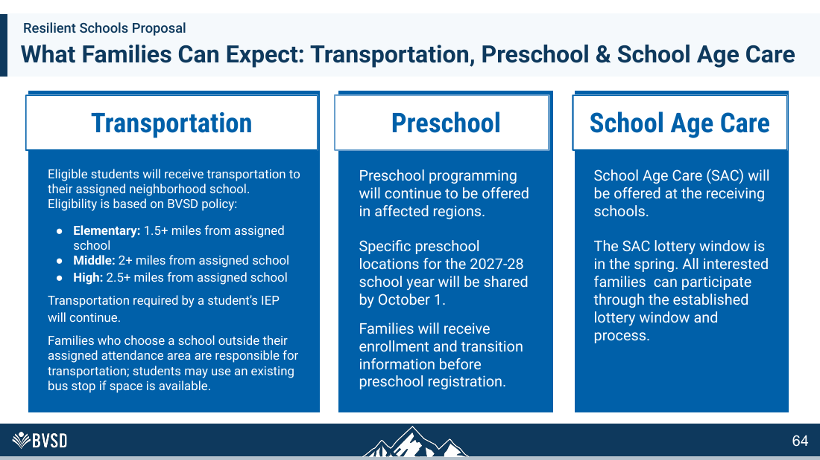
RESPONSE TO BVSD SLIDE 64
Families absorb the hidden costs
THE ANSWER
•
Children under 1.5 miles from an assigned elementary school may receive no bus even when the new trip is impractical.
•
More driving means congestion, emissions and family time.
•
SOLUTION: Fund transportation and crossing solutions so families do not absorb the plan’s hidden costs.
BVSD’S SLIDE
64 / 75
Notes:
[Sources]
- User-supplied: BVSD Board Union Solutions Brief (September 2, 2026)
- BVSD Collective Bargaining and Staffing Cliffs Board Brief (September 2026)
- BVSD 2026-27 Proposed Budget, School Allocation Formulas
[/Sources]

Slide 67

SOLUTION: Create an employee stabilization pool using vacancies, attrition and voluntary transfers before displacement.
Employee protections are real—but closure is not required
THE ANSWER
•
BVEA transfer/RIF rules, BVEOP placement rules and BVPA displacement protections govern what happens after staffing changes.
•
They do not require BVSD to choose closure as the staffing change.
BVSD’S SLIDE
65 / 75
Notes:
[Sources]
- User-supplied: BVSD Board Union Solutions Brief (September 2, 2026)
- BVSD Collective Bargaining and Staffing Cliffs Board Brief (September 2026)
- BVSD 2026-27 Proposed Budget, School Allocation Formulas
[/Sources]

Slide 68
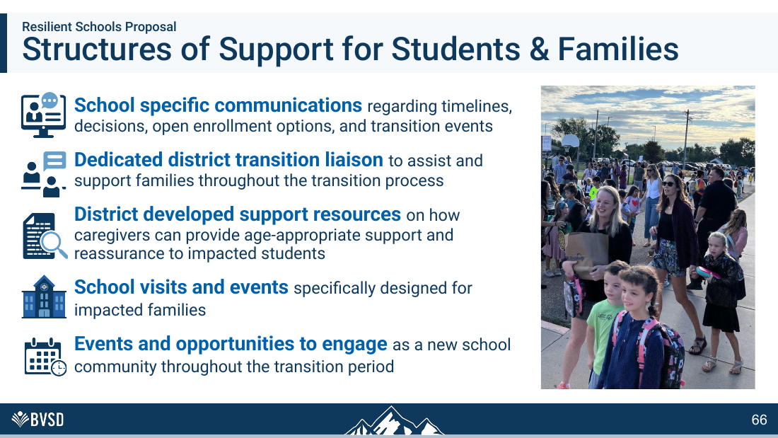
RESPONSE TO BVSD SLIDE 66
Negotiate stability before displacing employees
THE ANSWER
•
Use a one-year stabilization pool, vacancies, attrition and voluntary transfers before involuntary placement.
•
For paras, preserve benefits and add follow-the-program guarantees when services move.
•
SOLUTION: Track wellbeing and outcomes, but first test staffing reform that prevents the disruption entirely.
BVSD’S SLIDE
66 / 75
Notes:
[Sources]
- User-supplied: BVSD Board Union Solutions Brief (September 2, 2026)
- BVSD Collective Bargaining and Staffing Cliffs Board Brief (September 2026)
- BVSD 2026-27 Proposed Budget, School Allocation Formulas
[/Sources]

Slide 69

RESPONSE TO BVSD SLIDE 67
The contracts support a better transition strategy
THE ANSWER
•
BVCEA already ties custodial staffing to building square footage—proof that open buildings have fixed costs beyond headcount.
•
Smooth its staffing ladder, replace the per-pupil COLA trigger and create a voluntary facilities float team.
•
SOLUTION: Publish final enrollment, staffing and program guarantees before—not months after—the closure vote.
BVSD’S SLIDE
67 / 75
Notes:
[Sources]
- User-supplied: BVSD Board Union Solutions Brief (September 2, 2026)
- BVSD Collective Bargaining and Staffing Cliffs Board Brief (September 2026)
- BVSD 2026-27 Proposed Budget, School Allocation Formulas
[/Sources]

Slide 70

RESPONSE TO BVSD SLIDE 68
Four unions need four targeted solutions
THE ANSWER
•
BVEA: smooth sections and specialists. BVCEA: CPI COLA and custodial glidepath.
•
BVEOP: voluntary placement and front-office baseline. BVPA: graduated displacement and benefit continuity.
•
SOLUTION: Negotiate float pools, voluntary placement, benefit continuity and smoother FTE changes with all four unions.
BVSD’S SLIDE
68 / 75
Notes:
[Sources]
- User-supplied: BVSD Board Union Solutions Brief (September 2, 2026)
- BVSD Collective Bargaining and Staffing Cliffs Board Brief (September 2026)
- BVSD 2026-27 Proposed Budget, School Allocation Formulas
[/Sources]

Slide 71

SOLUTION: Add a formal baseline-formula review and joint labor working session to the Board’s next steps.
The Board is voting before testing the fix
THE ANSWER
•
The Board can adopt baseline staffing, rolling averages, buffers, hold-harmless funding and a reserve through the budget.
•
Targeted contract reopeners can address the remaining cliffs during fall 2026 and spring 2027.
BVSD’S SLIDE
69 / 75
Notes:
[Sources]
- User-supplied: BVSD Board Union Solutions Brief (September 2, 2026)
- BVSD Collective Bargaining and Staffing Cliffs Board Brief (September 2026)
- BVSD 2026-27 Proposed Budget, School Allocation Formulas
[/Sources]

Slide 72

RESPONSE TO BVSD SLIDE 70
Placement procedures are not a closure command
THE ANSWER
•
Contracts describe transfer, bumping, recall and RIF processes after BVSD changes staffing.
•
BVSD must identify any clause that allegedly prevents it from choosing a no-closure staffing model.
•
SOLUTION: Pause the September 22 vote while Board-controlled formulas are redesigned and targeted reopeners begin.
BVSD’S SLIDE
70 / 75
Notes:
[Sources]
- User-supplied: BVSD Board Union Solutions Brief (September 2, 2026)
- BVSD Collective Bargaining and Staffing Cliffs Board Brief (September 2026)
- BVSD 2026-27 Proposed Budget, School Allocation Formulas
[/Sources]

Slide 73

RESPONSE TO BVSD SLIDE 71
Next steps must separate Board action from bargaining
THE ANSWER
•
BOARD NOW: baseline services, rolling averages, buffers, reserve, transparent formulas and appeals.
•
NEGOTIATE: specialist smoothing, float pools, voluntary placement, benefit continuity and RIF simplification.
•
SOLUTION: Hold school-level hearings and require written answers to the twelve contract-and-cost questions.
BVSD’S SLIDE
71 / 75
Notes:
[Sources]
- User-supplied: BVSD Board Union Solutions Brief (September 2, 2026)
- BVSD Collective Bargaining and Staffing Cliffs Board Brief (September 2026)
- BVSD 2026-27 Proposed Budget, School Allocation Formulas
[/Sources]

Slide 74

RESPONSE TO BVSD SLIDE 72
BVSD knows when evidence is incomplete
THE ANSWER
•
The district paused dual-language changes because feedback and analysis were insufficient.
•
The same standard should apply where transportation, preschool, SAC and staffing details remain incomplete.
•
SOLUTION: Apply the same pause standard until transportation, staffing, program and fiscal evidence is complete.
BVSD’S SLIDE
72 / 75
Notes:
[Sources]
- User-supplied: BVSD Board Union Solutions Brief (September 2, 2026)
- BVSD Collective Bargaining and Staffing Cliffs Board Brief (September 2026)
- BVSD 2026-27 Proposed Budget, School Allocation Formulas
[/Sources]

Slide 75

RESPONSE TO BVSD SLIDE 73
Incomplete feedback requires a pause
THE ANSWER
•
BVSD acknowledges limited Spanish-speaking parent feedback.
•
That is not a minor process gap when equity is a stated district value.
•
SOLUTION: Extend outreach and publish responses before taking an irreversible vote affecting underheard families.
BVSD’S SLIDE
73 / 75
Notes:
[Sources]
- User-supplied: BVSD Board Union Solutions Brief (September 2, 2026)
- BVSD Collective Bargaining and Staffing Cliffs Board Brief (September 2026)
- BVSD 2026-27 Proposed Budget, School Allocation Formulas
[/Sources]

Slide 76

RESPONSE TO BVSD SLIDE 74
Research should come before decisions
THE ANSWER
•
BVSD plans a systematic research review for dual language in spring 2027.
•
Apply that discipline now to school size, closures, belonging, transportation and receiving-school capacity.
•
SOLUTION: Complete the research on school size, belonging, transportation and functional capacity before voting.
BVSD’S SLIDE
74 / 75
Notes:
[Sources]
- User-supplied: BVSD Board Union Solutions Brief (September 2, 2026)
- BVSD Collective Bargaining and Staffing Cliffs Board Brief (September 2026)
- BVSD 2026-27 Proposed Budget, School Allocation Formulas
[/Sources]

Slide 77
RESPONSE TO BVSD SLIDE 75
Research the contracts before claiming they force closure
THE ANSWER
•
BVSD has four CBAs; two other employee frameworks are not collective-bargaining agreements.
•
Publish the legal analysis distinguishing mandatory contract terms from discretionary budget formulas.
•
SOLUTION: Adopt baseline-plus-variable staffing now; negotiate the remaining cliffs; test both before closing schools.
BVSD’S SLIDE
75 / 75
Notes:
[Sources]
- User-supplied: BVSD Board Union Solutions Brief (September 2, 2026)
- BVSD Collective Bargaining and Staffing Cliffs Board Brief (September 2026)
- BVSD 2026-27 Proposed Budget, School Allocation Formulas
[/Sources]

Slide 78
What the Board should require before any closure
01
A funded no-closure option with minimum staffing floors per building
02
A published alternatives matrix with net costs and student impacts
03
School-level limits for enrollment, traffic, lunch and class size
04
Independent review of forecasts, savings and transition costs
05
Affected-school hearings—and binding program guarantees—before a vote
Until then: vote no.
Notes:
[Sources]
- https://go.boarddocs.com/co/bvsd/Board.nsf/pfiles/DXBFUX40E0C7/$file/Resilient%20Schools%20Proposal%20FINAL%2008-25-2026%20(1).pdf
- https://www.bvsd.org/fs/resource-manager/view/a3084131-2460-4b0e-b752-d0f82216f12d
- https://www.bvsd.org/current-topics/declining-enrollment
- https://boulderreportinglab.org/2026/08/25/bvsd-proposes-closing-four-elementary-schools-in-sweeping-consolidation-plan/
- https://www.ed.gov/media/document/descriptive-evaluation-of-federal-class-size-reduction-program-final-report-2004-107010.pdf
- https://www.researchforaction.org/wp-content/uploads/2024/06/revisiting-research-on-school-closings-key-learnings-for-district-and-community-leaders.pdf
- https://nces.ed.gov/pubs2003/fim/ch_3.asp
[/Sources]

